Slide 1
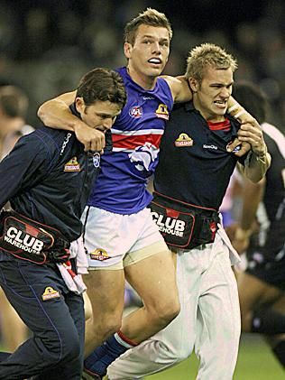
Prevention and management of injuries IN SENIOR Australian rules football
Paul Greco – Physiotherapist

Slide 2
Outline:
Basic Anatomical Terminology
Injury Classification
Acute vs. Chronic Injuries
Management of Acute Injuries
Management of Chronic Injuries
The Role of the Coach/Effective Communication
Litigation/Negligence
Injury Prevention Guidelines
Questions

Slide 3
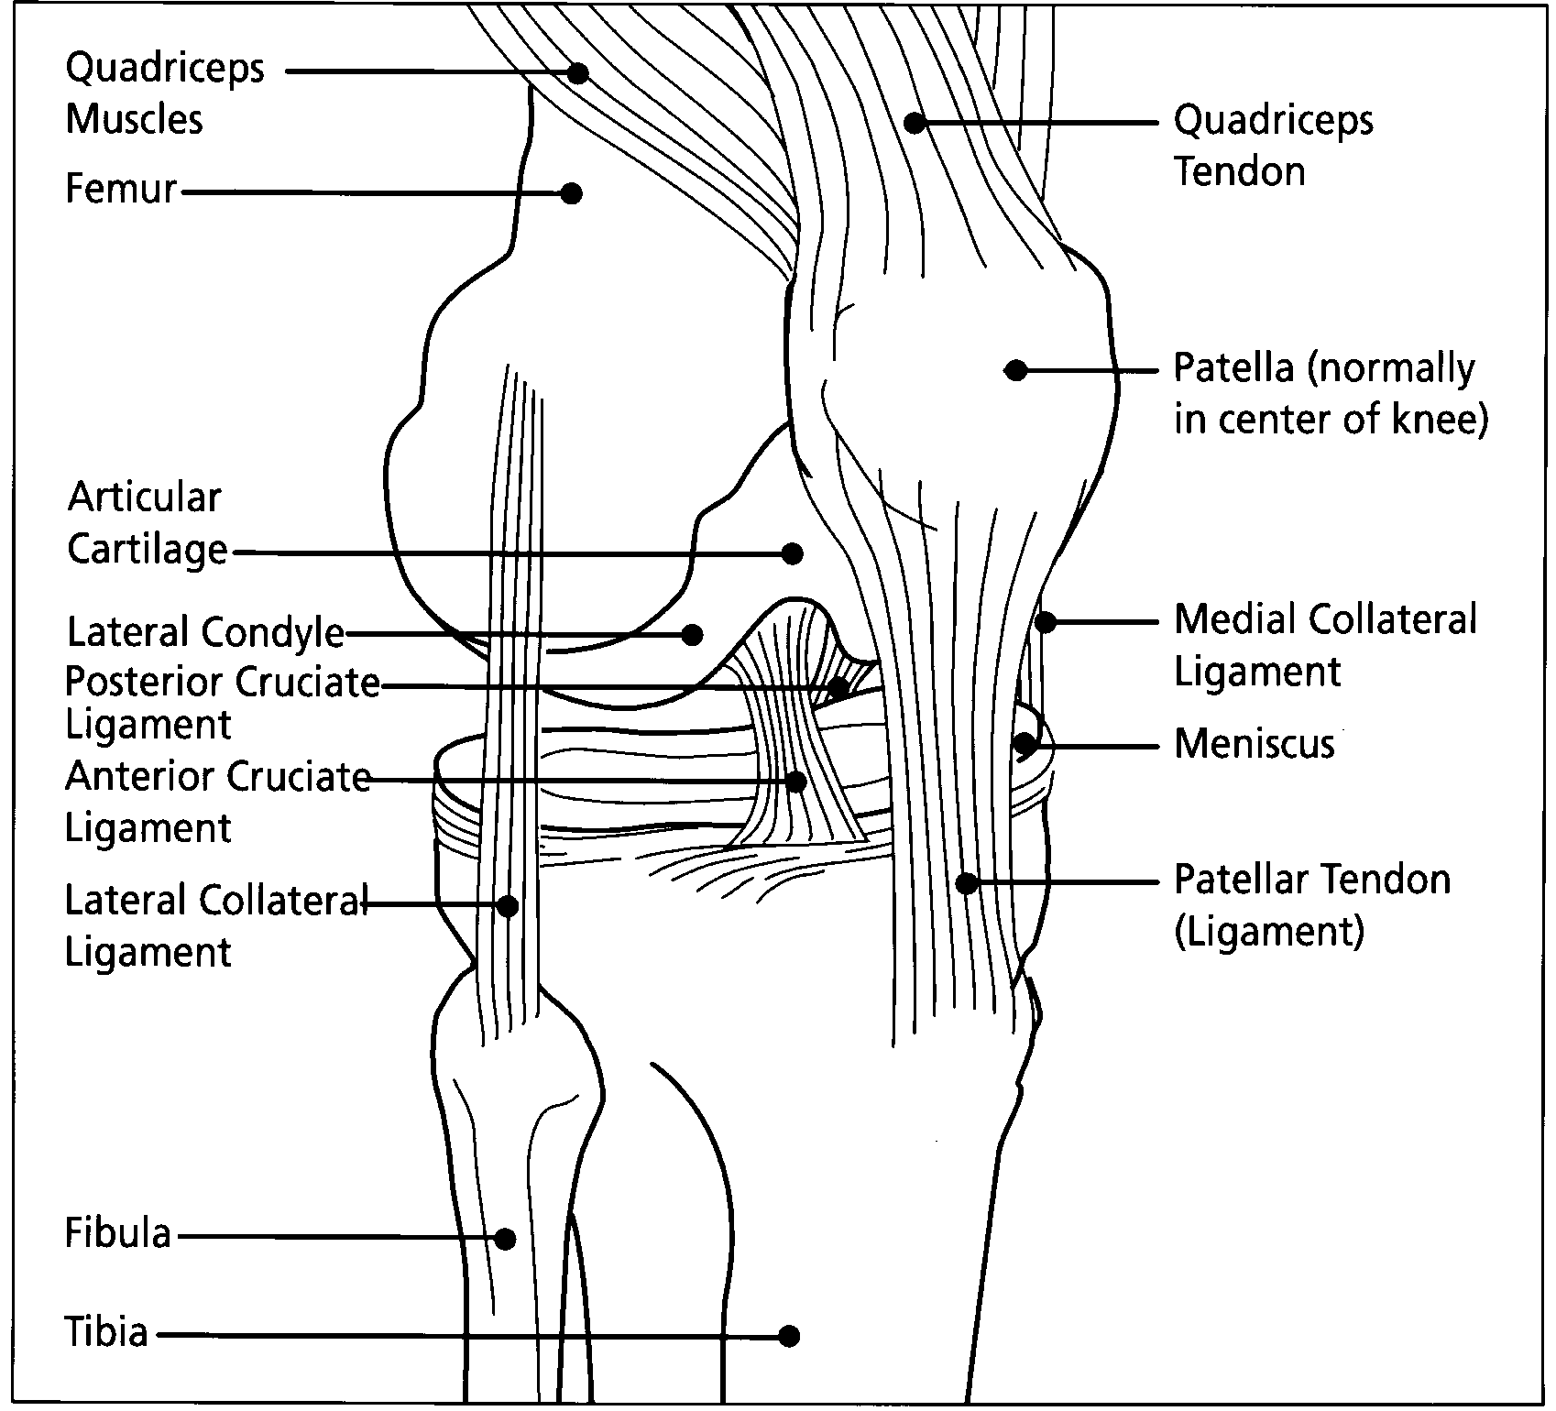
Basic Anatomical Terminology
Tendon
Muscle
Cartilage
Bone
Ligament

Slide 4
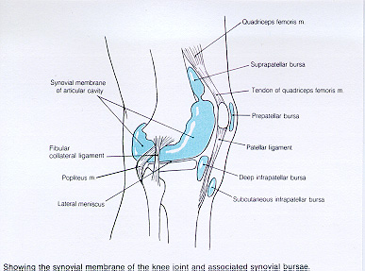
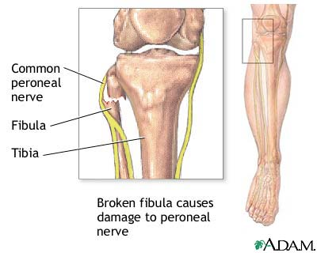
Basic Anatomical Terminology
Bursa
Nerve
Bursa
Bursa
Joint Capsule

Slide 5
Injury Classification
Classically graded 1-3
Ligaments and muscles most common for ARF
Fractures different
displaced
undisplaced
comminuted
transverse
oblique
compound
avulsion

Slide 6
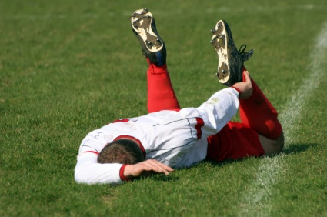
Types of Injuries:
Injuries are either acute or chronic/overuse:
Acute injuries:
Occur from a collision, fall, sudden change in direction
Usually involve immediate cessation of activity
Varying levels of pain
Need immediate assistance
Chronic/Overuse injuries:
Gradual onset
Not related to any one incident
Periodic decline in game play ability
Usually associated with low level constant pain
Hard to manage
Can last for long periods of time if left unmanaged
WARNING SIGNS:
Decreased running ability
Decreased kicking distance
Generalised decrease in agility
Gait pattern/Resting pain

Slide 7
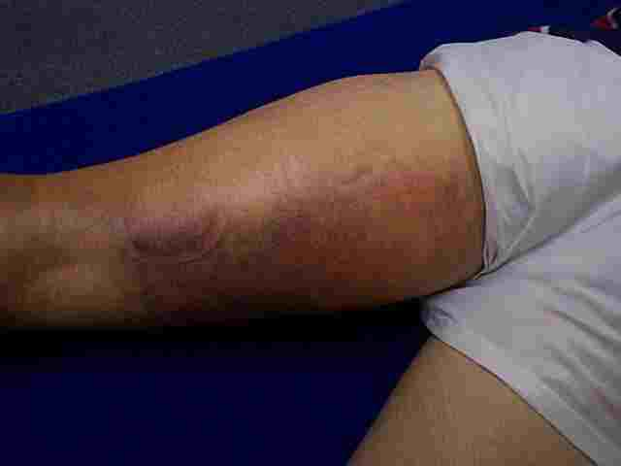
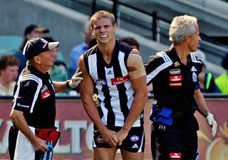
Common Acute Injuries in ARF:
Fractures
Dislocation/Subluxation
Sprain/Tear/Rupture
Contusions/corkies
Lacerations/abrasions
Uncommon - Neuropraxia

Slide 8
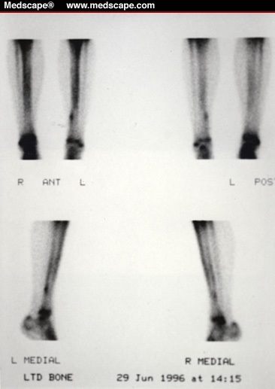
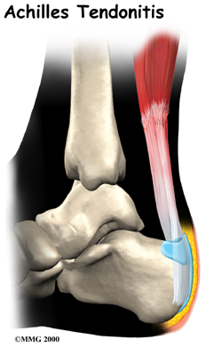
Common Chronic Injuries in ARF:
Stress Fracture
Osteitis/Periostitis/Apophysitis
Chondropathy – sore cartilage
Synovitis/Osteoarthritis
Compartment Syndrome
Tendonopathy
Bursitis - uncommon

Slide 9
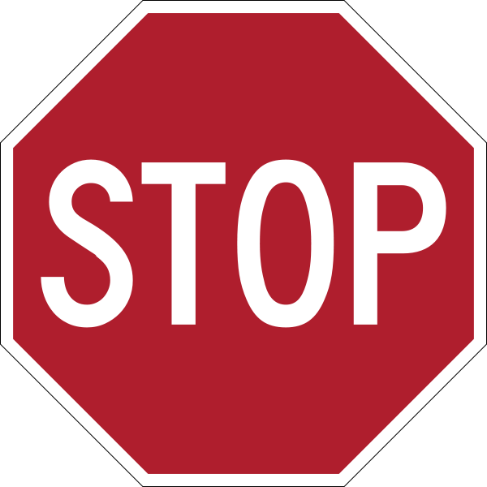
Acute Injury Management:
Stop
Think
Observe
Plan

Slide 10
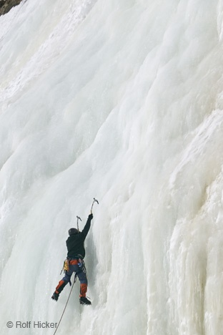
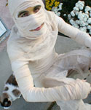
Acute Injury Management:
Rest
Ice
Compression
Elevation
Refer on

Slide 11
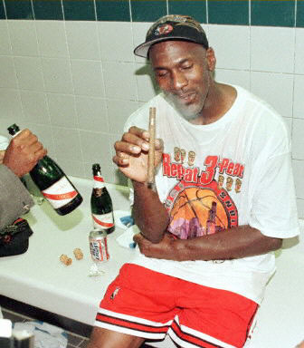
Acute Injury Management:
NO
Heat
Alcohol
Running
Massage

Slide 12
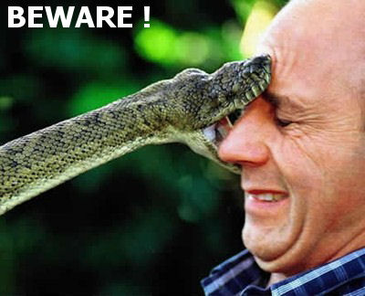
Acute Injury Management:
DRABC
Danger
Response
Airway
Breathing
Compressions

Slide 13
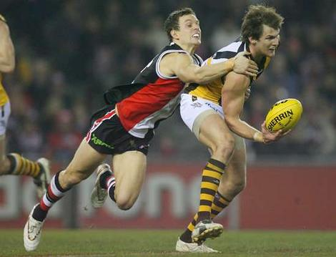
Chronic Injury Management:
MUST BE APPROPRIATELY PLANNED
Communication more important due to longevity of symptoms
Modified Training
Must consider
Load
Intensity
Player position
Game Time
Time in Season

Slide 14
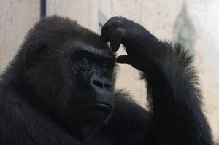
So what do we do?
Understand that injuries are not simple
Communication is the key
Learn warning signs
Develop good liaison relationships with health professionals
Prevention is better than cure

Slide 15
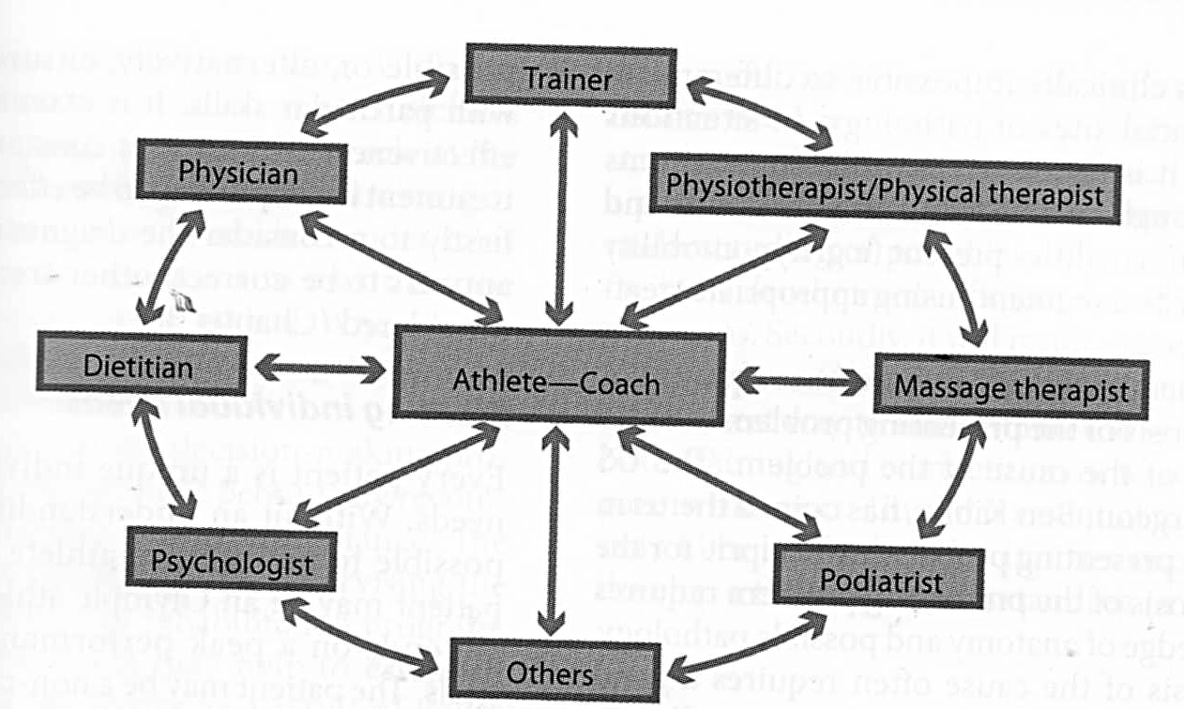
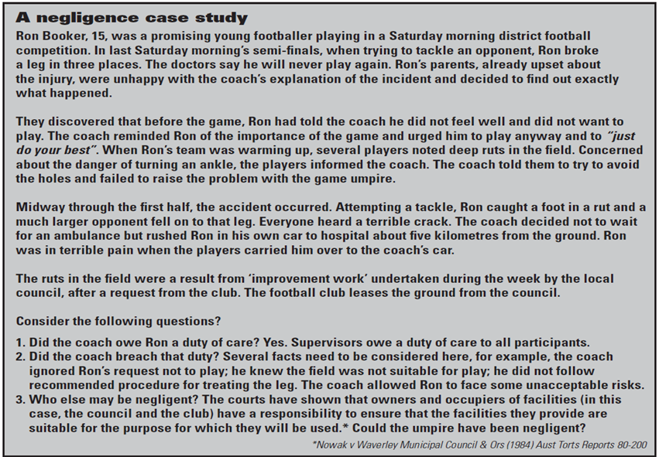
The Role of the Coach
Effective Communicator
Learn to refer – legal issues
Must consider duty of care
“the legal obligation to take reasonable care to avoid causing harm”.
Negligence
“the charged placed on the individual who does NOT take reasonable care to avoid causing harm.

Slide 16
The Role of the Coach
Some suggestions in dealing with injury management:
Delegate an Injury Management Representative (usually fitness coach)
Tread carefully with personal experience
Liaise with other professionals
Understand and respect professional advice

Slide 17
Injury Prevention Guidelines:
Screening (resources)
Warm-up – Cool down
Stretching – controversial?
Taping and bracing
Protective Equipment
Appropriate Training
Diet and Hydration
Recovery Techniques

Slide 18
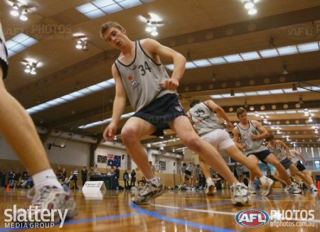
Screening
Specific health risks for senior ARF players (medical vs. musculoskeletal health)
Pre-season/mid season?
Correlation of data – time and resources
Controversial as to reliability of data
Need professional advice
All AFL clubs complete several screenings throughout year

Slide 19
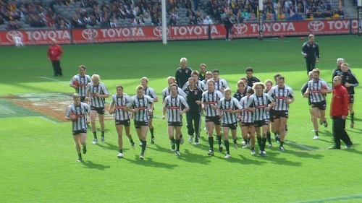
Warm-up and Cool Down:
Generalised increase in blood flow
Is sport specific – replicate game play at low levels
Assists with muscle elasticity
Improves neural firing patterns
Assists with removal of waste products/helps prevent DOMS

Slide 20
Stretching
Controversial
Must look at research properly
Longevity of stretching (Ancient Greeks)

Slide 21
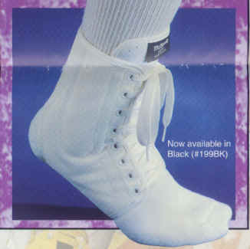
Taping/Bracing
Consider individual – taping vs. bracing
Not compulsory if no past history
Both modalities are acceptable
Ensure appropriate strapping (professional advice)

Slide 22
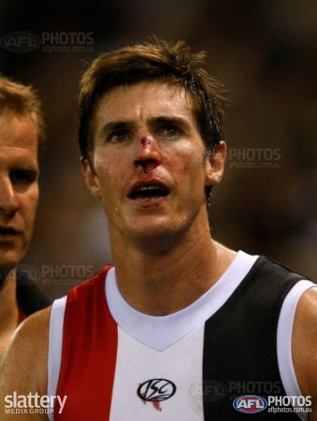
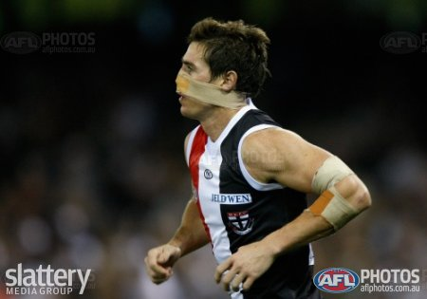
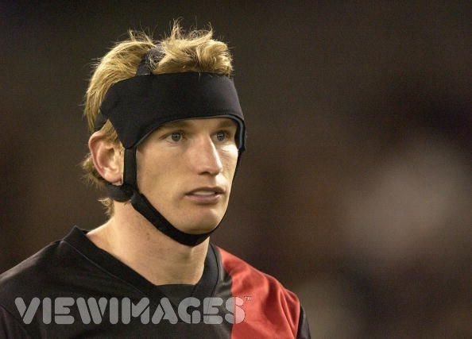
Protective Equipment
Taping (wound dressing) – blood rule
Shin guards (ruckmen)
Hip protectors
Bubble wrap (following deep corky)
Mouth Guards
Thermosplint braces
Helmets

Slide 23
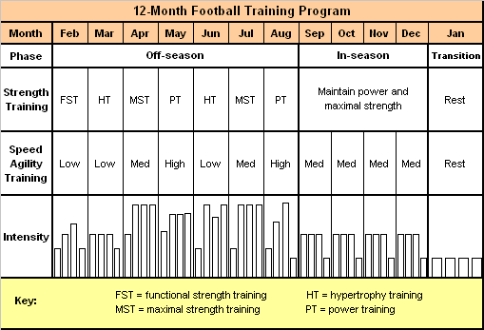
Appropriate Training
Pre Season – training must be specific
Consider Cross Training
Ensure different phases (aerobic/endurance/strength/taper etc)

Slide 24
Diet/Hydration
Glycogen Replacement – ensure adequate restoration within 24 hours
General intake = 7-12 g CHO/kg of BW/day
High CHO load can ensure quicker recovery in muscle glycogen stores
Hydration vital
General guildeline – 1kg lost = 1 litre needed
Electrolytes more important than expected

Slide 25
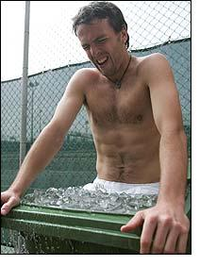
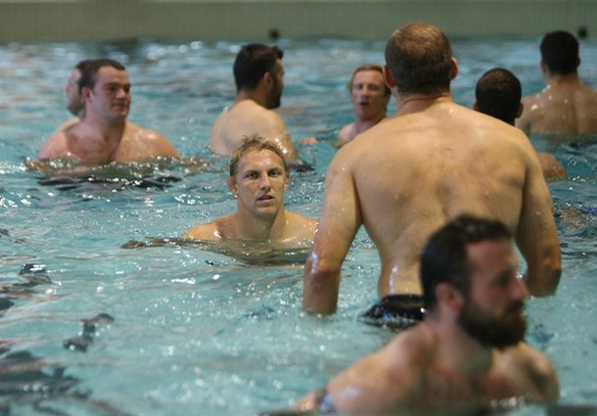
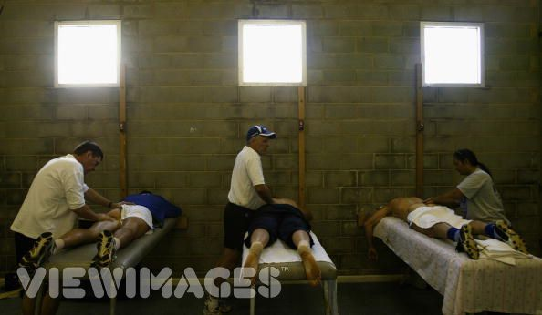
Recovery Techniques
Ice baths
Recovery Swims
Massage

Slide 26
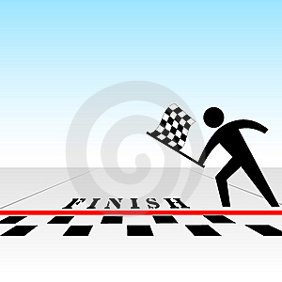
THANK YOU! email:
paul@pinnaclehealthgroup.com.au

