Slide 1
City of Sydney Basketball Association
Sponsorship Packages | 2016

Slide 2
CSBA Ideology
Mission Statement
To conduct a community-based basketball program at the highest level.
Vision Statement
To be recognised as an Association that develops people to their full potential.
Core Purpose
To develop players, coaches and officials to their highest potential.

Slide 3
CSBA Aims
Encourage basketball involvement in a fair, safe and friendly environment, and provide training and development opportunities for members to improve their skills
Promote basketball to all age groups in the City of Sydney Council area and surrounding regions
Develop basketball players, coaches and officials at all levels
Conduct basketball competitions that are of a high standard
Basketball

Slide 4
CSBA Member Base & Reach
More than 2,500 registered members
compete weekly at Alexandria and Marrickville.
6,000+ people visit our venues on a weekly basis.
1, 000+ Facebook followers

Slide 5
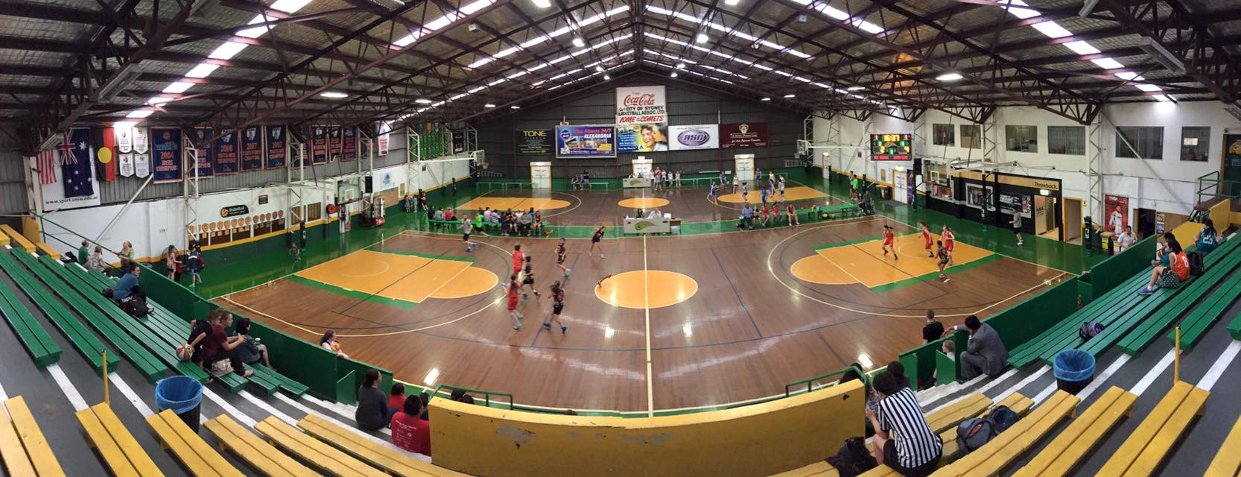
Become Part of the
Sydney Comets Family

Slide 6
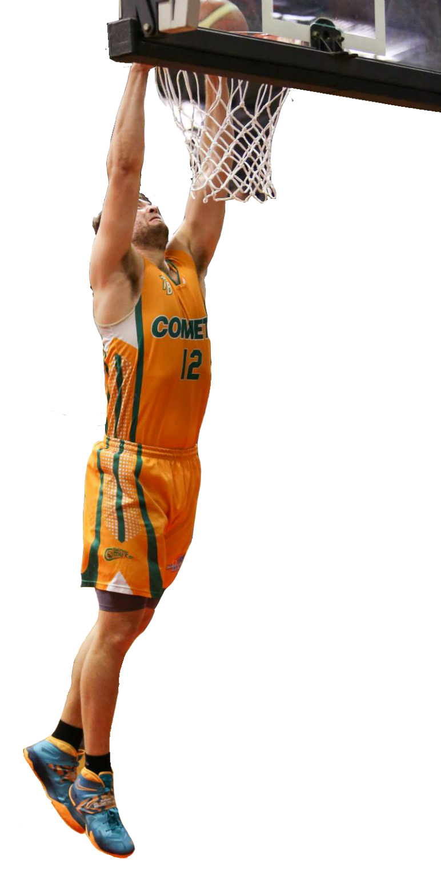
Sponsorship Snapshot
 | Championship Package | Metro League Package | Official Partner | Club Member
Logo on Uniforms | x | x
Logo on Warm up Jerseys | x
Catered Corporate Box | x |  | x
Courtside Signage | x
Game Day Sponsorship Announcements | x | x | x
6m x 3m Advertising Stadium signage | x | x
Game Night Sponsor Positioning | x |  | x
Team Appearances | x
Match Day Program Positioning | x | x
Logo on CSBA Website | x | x | x | x
Link on CSBA Website | x | x | x | x
Live Match Webcasts & Live Streaming | x
Framed and Signed Team Jersey & Photo | x | x
Pre & Post Game Function Attendance | x |  | x
Trade Table on Game Day | x | x | x
Tickets to End of Season Presentation | x | x | x | x
General Admission Game Day Tickets | x | x | x | x
General Admission to Feature Games | x | x | x | x
Cost | POA* | POA* | POA* | $750*
Prices exclude GST. Championship Package, Official Partner and Metro League Package are 2 year agreements.
*POA - Price on application

Slide 7
Championship Package
POA* - 2 Year Agreement
Program Highlights
Waratah State League Men’s Program
2015 Waratah League Champions
2014, 2013, 2012 Runners Up
Waratah State league Women’s Program
2008 Waratah League Champions
*POA – Price on application

Slide 8
Championship Package
What you get…
Your company logo on playing uniforms and the sleeve of warm-up tops
Catered Corporate Box for all Waratah League home games for up to 6 people
6 General Admission tickets to all Waratah League home games
4 general admission tickets to feature games hosted at Alexandria (e.g.: NCAA)
Live webcast access to all Waratah Men’s and Women’s home games
Social Media campaign*
Courtside signage rights at CSBA stadium and one 6 x 3 metre stadium sign
Game night sponsor positioning for 2 home games per season
Advertising feature in program
Promotional product distribution on game night
Game night announcements
Team appearances at designated company events*
*Confirmed by negotiation. Note: All benefits are negotiable and dependant on the needs of the partner.

Slide 9
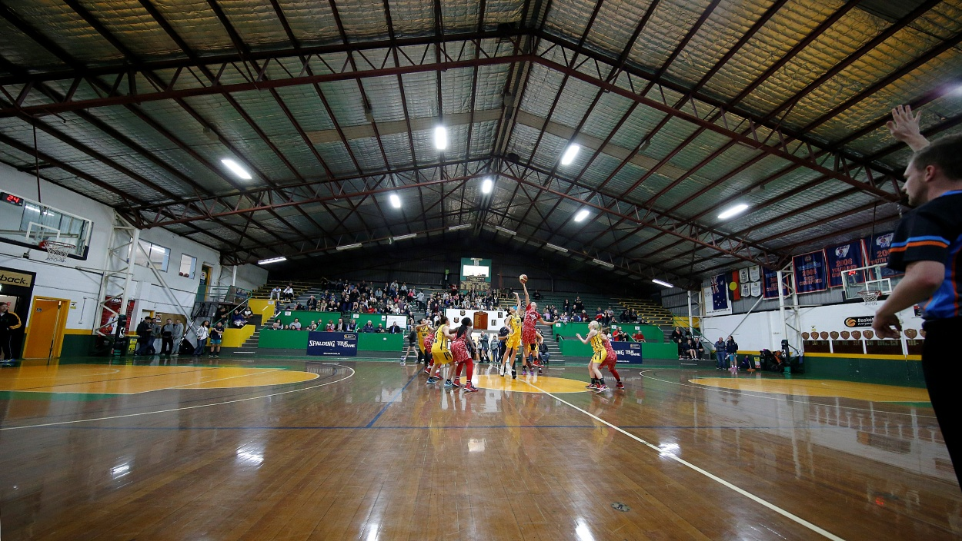
Championship Package
Prominent positioning in all home game programs
Drive traffic to your website and increase your brand awareness with your logo and click through link on CSBA website and Facebook page
Framed and signed team photo and jersey for display
Attendance at pre and post game functions
Trade table display on game night
6 tickets to end of season presentation dinner

Slide 10
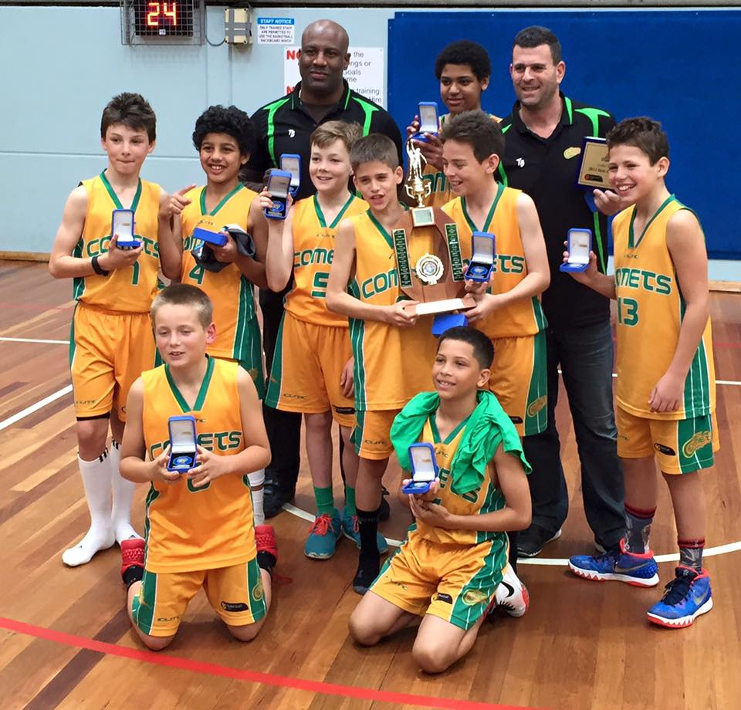
Metro League Package
POA* - 2 Year Agreement
Program Highlights
Over 150 Junior Comets representatives
2015 U14 Boys National Championships top 8
Winner of recent National Junior Classic
Games played throughout Sydney and NSW
*POA – Price on application

Slide 11
Metro League Package
What you get…
Logo on all Comets junior playing uniforms (shorts and singlets)
One 6 x 3 metre stadium sign
2 general admission tickets to all Waratah League home games
2 general admission tickets to feature games hosted at Alexandria (e.g.: NCAA)
Promotional product distribution on game days, including sponsor announcements
Prominent positioning in all home game programs
Drive traffic to your website and increase your brand awareness with your logo and click through link on CSBA website and Facebook page
Framed and signed team photo and jersey for display
Trade table display on game day
6 tickets to end of season presentation dinner
Note: all benefits are negotiable and dependant on the needs of the partner.

Slide 12
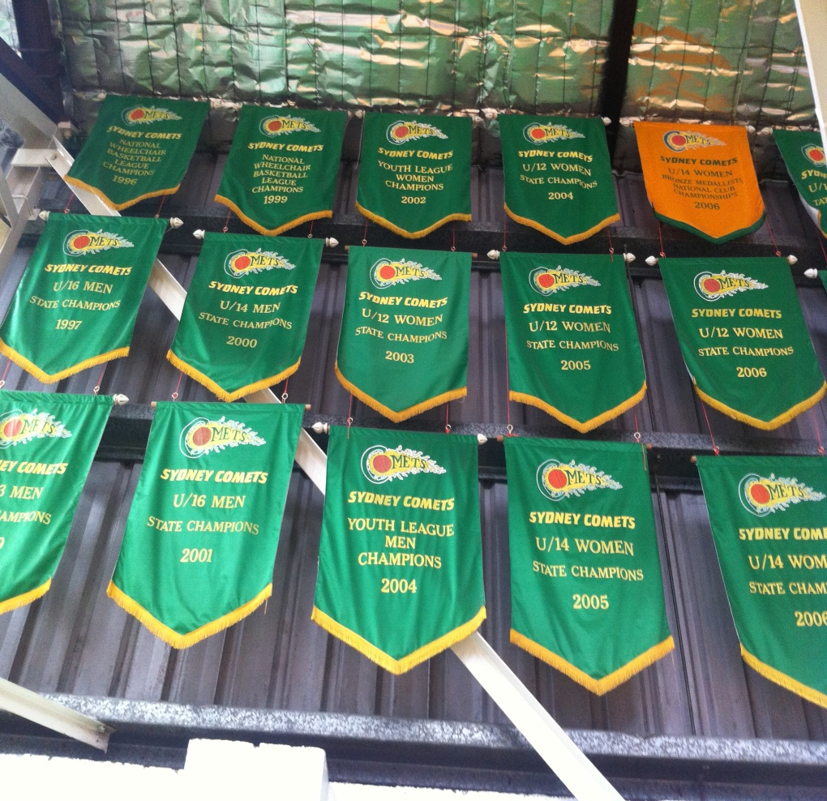
Official Partner
ADD IMAGE
POA* - 2 Year Agreement
Program Highlights
Over 150 Junior representatives
2015 U14 Boys National Champs top 8
2015 U12 Boys State Champions
Winner of recent National Junior Classic
Games played in Sydney and around NSW
2015 Waratah League Champions - Men
2014, 2013, 2012 Runners Up – Men
2008 Waratah League Champions - Women
* POA – Price on application

Slide 13
Official Partner
What you get…
Catered Corporate Box for up to 6 people at every Waratah League home game
6 general admission tickets for each Waratah League home game
2 general admission tickets to feature games hosted at Alexandria (e.g.: NCAA)
Prominent signage positioning on show court area
Drive traffic to your website and increase your brand awareness with your logo and click through link on CSBA website and Facebook page
Attendance at pre and post game functions
Trade table display on game night
Partnership acknowledgement at all home games
2 tickets to end of season presentation dinner
Framed and signed team photo and jersey for display
Note: all benefits are negotiable and dependant on the needs of the partner.

Slide 14
Comets Club Membership
ADD IMAGE
Sponsor a Comet - $750
Program Highlights
Individually sponsor a player from any representative team, from the junior or senior program.
Player calibre includes state, national and NCAA representatives.
*Annual price, excluding GST

Slide 15
Comets Club Membership
What you get…
Drive traffic to your website and increase your brand awareness with your logo and click through link on CSBA website and CSBA Facebook page
2 general admission tickets to Waratah League matches
2 general admission tickets to NCAA feature matches played at Alexandria
2 tickets to end of season presentation dinner
Note: all benefits are negotiable and dependant on the needs of the partner.

Slide 16
Contact Us
For further details or to secure your partnership, please contact Mark Dalton City of Sydney Basketball Association e. manager@sydneybasketball.com.au p. 0409 387 178

