Slide 1
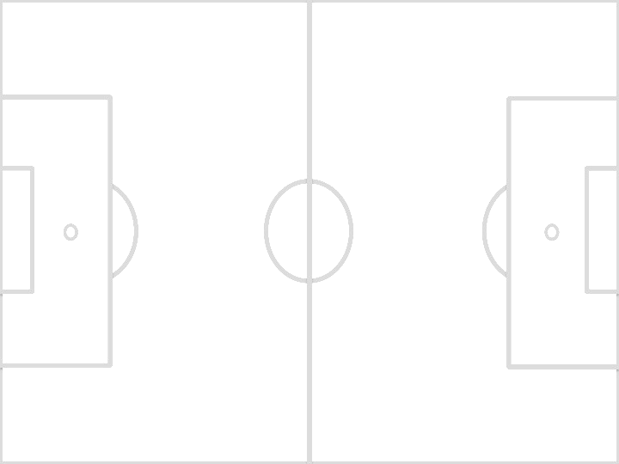
Waramanga Playing Fields Small sided Fields for U10 and U11s (9 Players v 9 Players) For 2017 Season
Goal Line
Goal Box
Full Field Touchline
12 x 5m
Set Up for 9v9 Football at Waramanga.
Used by all U10 and U11 teams.
All Under 10 and 11 Fields for 2017 will be marked with Black paint and laid out on Fields 101, 103, 104 and 108.
Dimensions vary across the fields as the full fields are of various sizes.
The Home team, listed first on the draw shall be responsible for setting up the field. If you are playing at Waramanga then it will be your team.
Corner Flags are selected from the Wheelie Bin at the Junior Container. Or can be re-used from any previous U8/9 game.
Use the aluminium Goal frames and their nets. Use the horseshoe shaped pegs to hold the frames down.
Goals are centred in the Goal Box on the Goal Line.
Each Team’s draw will show if you need to set up or pack away the goals.
Sometimes you will be required to set up and leave up for the following game.
Sometimes you will need to set up and pack away after your game.
If your Team needs to pack away there will be a reason. Usually there is a Match due to be played on the full field. Please ensure efficient clearing of the field, including spectators, so the next match can commence on time
40-46m
1.5m
1.5m
Full Field Goal Line
Touchline
60-66m
Touchline
Goal Box
Goal Line
Full Field Touchline

