Slide 1
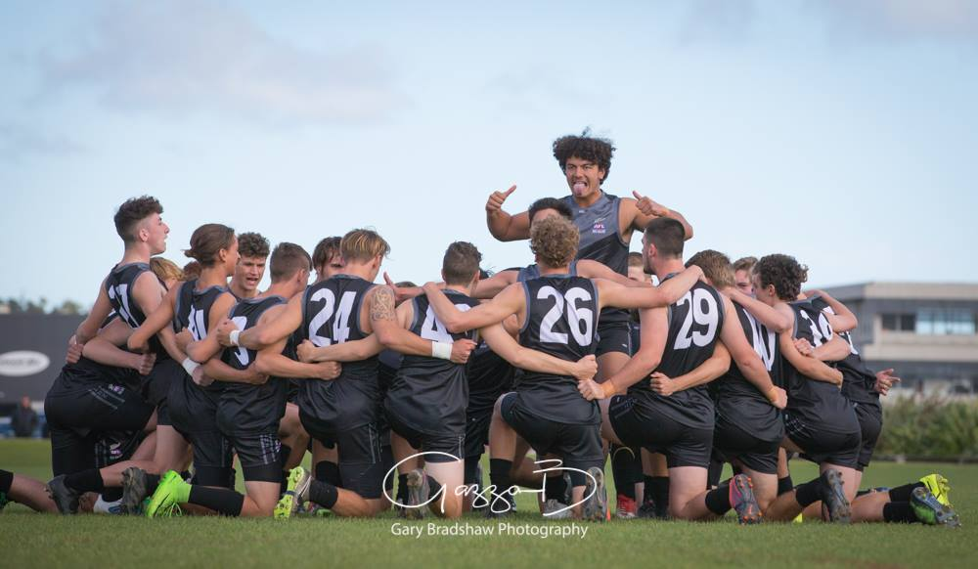
AFLNZ visit the MPJFL
MPJFL U17’s v AFLNZ U18’s
Friday 11th May is AFLNZ v MPJFL U17’s @ 6.00pm
Followed by Pearcedale v Mt Martha U12’s @ 7.45pm
Come down & witness the Haka Challenge, its not something you want to miss!
Jump No. | NAME | CLUB
1 | Jarvis Espie | SORRENTO
2 | Kaolan Thornton | PEARCEDALE/BAXTER
3 | Kade Timms | PEARCEDALE/BAXTER
4 | Reece Sherar | ROSEBUD
5 | Brendon Garbett | PEARCEDALE/BAXTER
6 | Riley Benwell | PEARCEDALE/BAXTER
7 | Benjamin Goates | RED HILL
8 | Baylen Benwell | PEARCEDALE/BAXTER
9 | Tom Hughes | RYE
10 | Lachlan Neil | STH MORNINGTON
12 | Bryce Ridsdale | PEARCEDALE/BAXTER
13 | Harry Capes | PEARCEDALE/BAXTER
14 | Josh Taylor | ROSEBUD
15 | Angus Rowler | STH MORNINGTON
16 | Joe Collins | STH MORNINGTON
17 | Aden Phillips | RED HILL
18 | Thomas Slattery | RED HILL
19 | Adam Harris | BALNARRING
20 | Anderson Millar | STH MORNINGTON
11 | Ethan Mills | SOMERVILLE
21 | Adam Walker | MT MARTHA
23 | Torin Bam | BALNARRING
24 | Declan Scully | PEARCEDALE/BAXTER
28 | Blake Kuipers | ROSEBUD
Name: | Region
Blake Williamson | Northland
Chaitania Proctor | Otago
Couper Jones | Auckland
Daniel Howie | Auckland
Declan Honan - Crann | Waitakere
Devin Pullyblank | Canterbury
Ethan Halton | Counties
Finn Moffat | Canterbury
Hayden Johnston | Otago
Jackson Hemmingsen | Auckland
James Dakin | Auckland
Jevaan Croft | Counties
Joseph Alesich-Tamariki | Harbour
Joshua Mackie | Otago
Joshua Morgan - Ranui | Wellington
Lewis Gill | Wellington
Luke Dunning | Harbour
Luke Williams | Counties
Manny Snooks | Northland
Misilifi Faimalo | Wellington
Quinn Pocock | Auckland
Sam Cairns | Brisbane
Samuel Anderson | Canterbury
William Kempt | Wellington

