Slide 1
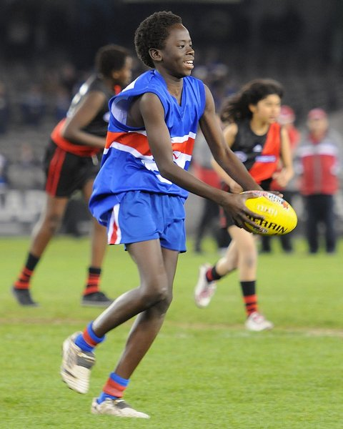
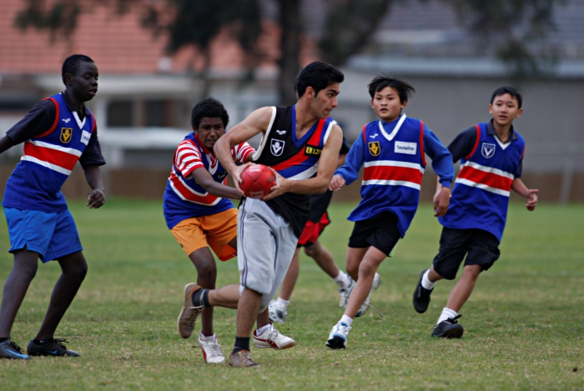
AFL Multicultural Program 2011

Slide 2
THE COMMUNITY CLUB
Our aims are:
To introduce Culturally and Linguistically Diverse (CALD) populations to Australian culture through Football and the Western Bulldogs
To engage communities in active Football programs and become fans of the AFL and Western Bulldogs
To influence community leagues, clubs and AusKick Centres to embrace multicultural diversity
To reach out to the local community and get them active and impacting their community in a positive way.

Slide 3
THE WEST’S DIVERSITY
VIC % LOTE spoken at home
VIC% Born Overseas
VIC % OSB NMESC

Slide 4
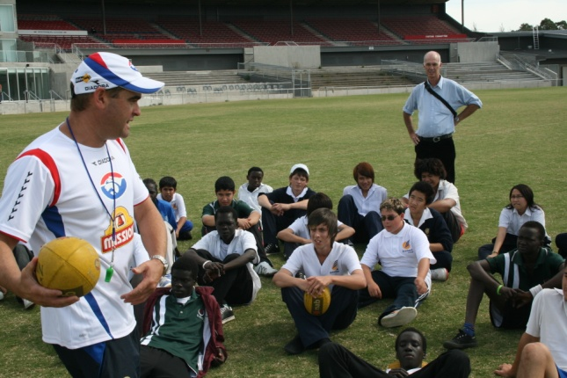
THE WEST’S CHALLENGE
The Western Region of Melbourne is an area of significant diversity and disadvantage as indicated by:
Over 95 nationalities represented in the Western Region
Lower levels of education than other parts of metropolitan Melbourne. School retention rates are also low and the west has the lowest rate of tertiary qualified graduates in metropolitan Melbourne
The region has the highest rate of unemployment (about 25% higher than the state and metropolitan rates)
The health of the Bulldogs Backyard population is poorer than other regions as evidenced by a number of indicators such as diabetes and obesity
Females are not actively encouraged to participate in sport

Slide 5
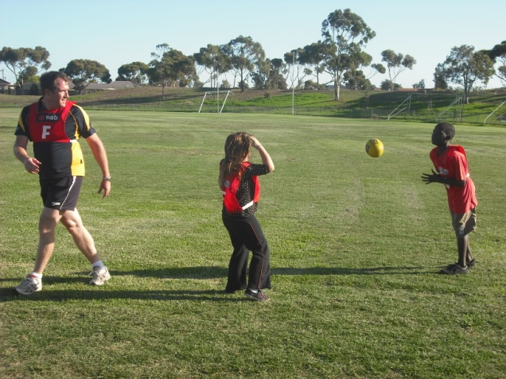
OUR CHALLENGES
Settlement Issues
Learning English
Restarting schooling or finding work
Adjusting to a new culture
Separation from extended family
Navigating unfamiliar systems and environment
Forging new social networks
Barriers
Unfamiliarity with the structure of sporting clubs and associations
Language barriers
Lack of priority given to sport by parents
Lack of transport
Fear of racism or discrimination
Cost

Slide 6
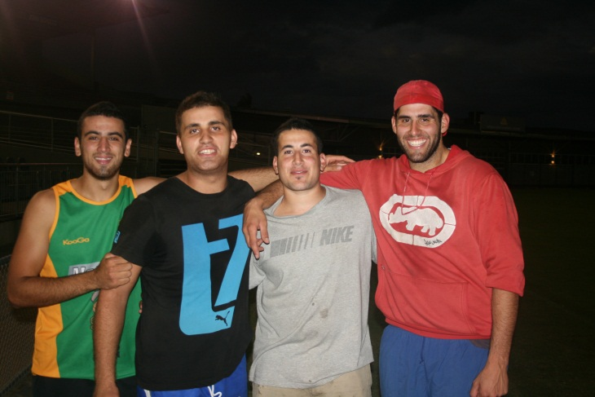
CREATE A SUPPORTIVE ENVIRONMENT
Car Pooling
Recycle uniforms and Equipment
Multicultural – One parent born overseas
Friendly
Smiles
Approachable
Make use of Community Buses
Flexible Payment Plans
Provide Maps/Bus and Train Timetable
Involve Families
Network with Schools, Youth Groups & Council

Slide 7
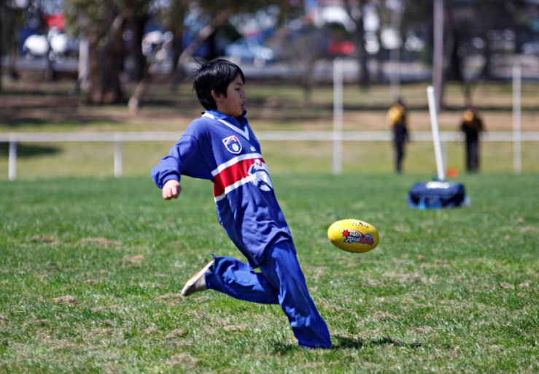
MULTICULTURAL SCHOOLS FOOTBALL PROGRAM
The AFL Multicultural Schools Football Program (MSP) is an introductory football program for schools with high CALD populations. The aim of the MSP is to develop opportunities to engage students from diverse cultural backgrounds to broaden both the participation and supporter base in Australian Football.
1,500 Students participate in the program annually
1000 Students and Parents were supplied tickets to the Round 12
match against Melbourne.
The program is designed around ‘Themes’, including ‘Harmony,
Teamwork, Fairplay, Respect, Leadership and Healthy Eating’
Multicultural Schools Cup for Primary Schools
ESL Cup for Secondary Schools
The Multicultural Schools Program (MSP) provides the foundation to the overall AFL Multicultural Program by introducing the game at its very basic level to children in our Multicultural Backyard.
Students having a kick at the Multicultural Schools Cup

Slide 8
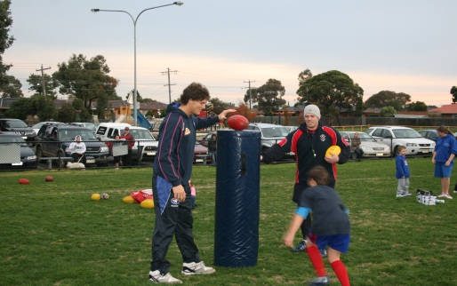
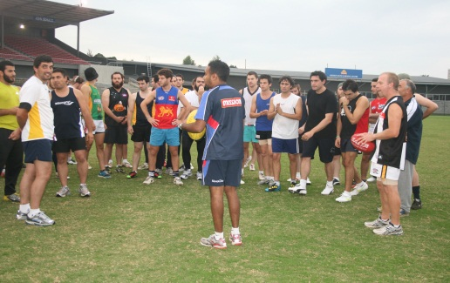
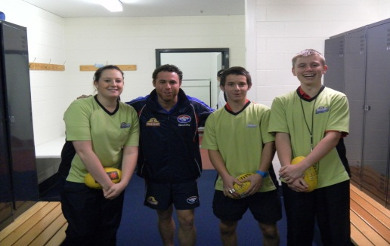
ENGAGING PARTICIPANTS
Promoting the Club
Language Centers
Ethnic Media
Come and Try Days
Schools
Benefits of being an inclusive club
More members means more income for the club
Opportunity to increase the number of skilled players in your club
Social benefits associated with new members and their family and friends participating
Potential to recruit volunteers and administrators
The opportunity to learn more about other cultures
Work in Partnership
Other sports providers (YMCA)
Schools
Community Leaders
Youth Workers
Community Service Providers
Centre of Multicultural Youth

Slide 9
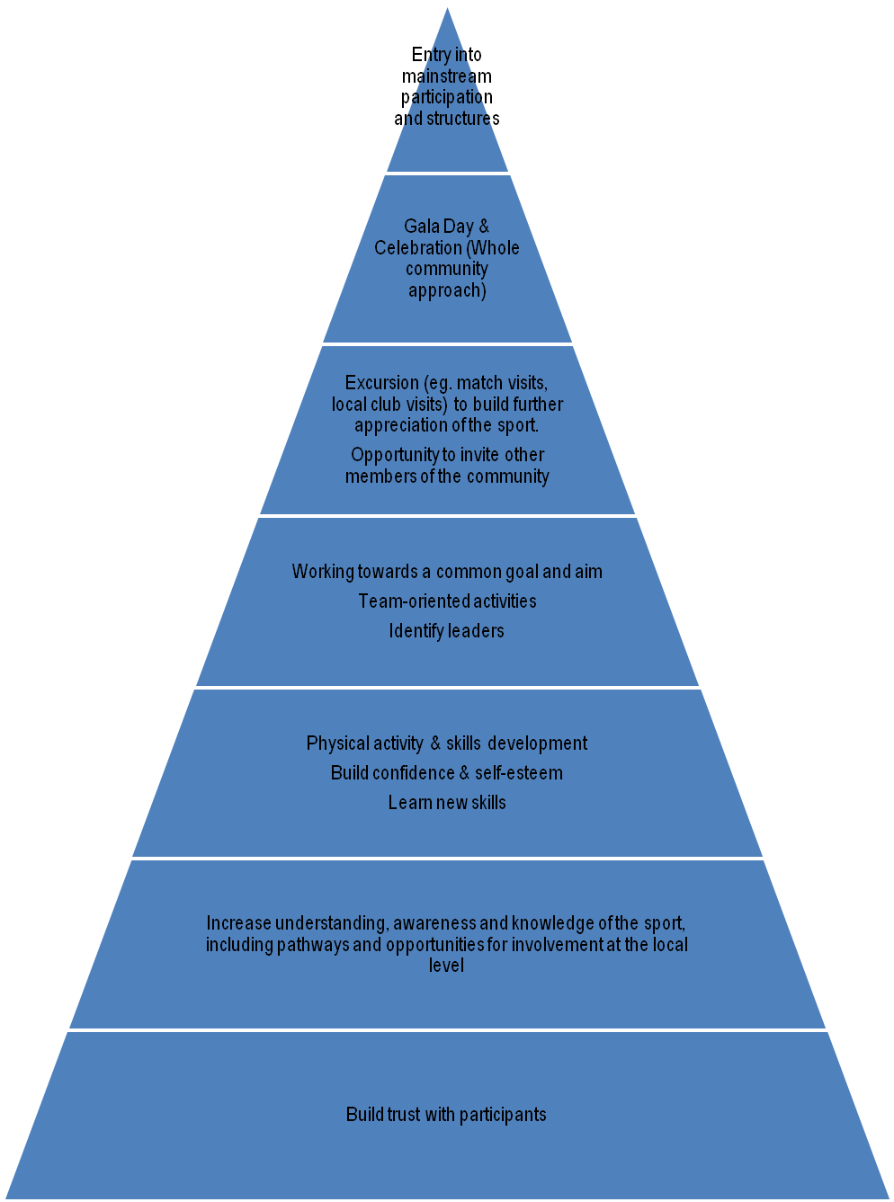
SPORTS ENGAGEMENT MODEL FOR INCLUSION

Slide 10
CONCLUSION
Integration and Inclusion
Have a plan/structure or goal in place
Centre of Multicultural Youth
Don't have the main goal of a Multicultural program being, ‘memberships to our club/Auskick Centre’, but more ‘participation of the sport’ and ‘promotion of our club’.
Communities are strong- Engage one and more will come
In 2025 overseas born families will overtake locally born families
Support from AFL Vic and the AFL Multicultural Program in the form of information sheets, cultural Awareness training and general advice.
Where possible, try to introduce yourself to a Bulldogs Friendly School, a list of schools being visited is available on request.
Multicultural Australians spending has doubled since 1991 and is now $60 billion a year.

Slide 11
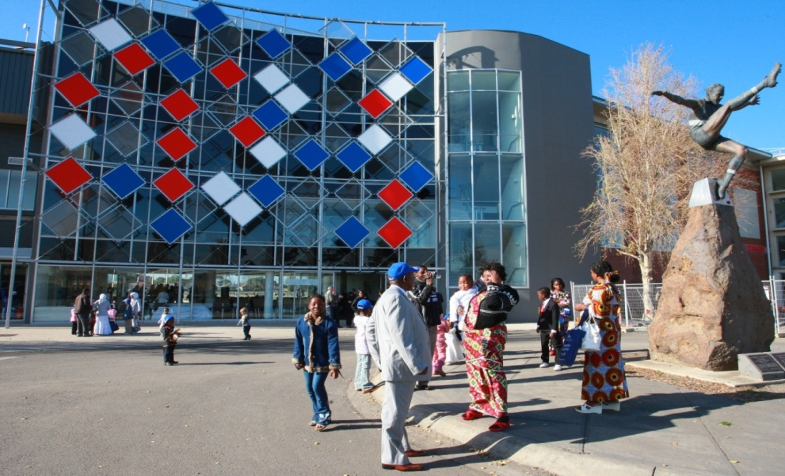
CONTACT DETAILS
Nish Moses
AFL Schools and Youth Development Coordinator
Western Bulldogs
Phone: 9680 6166
E-Mail: nish.moses@westernbulldogs.com.au

