Slide 1
Sport Education
Presentation by Oceania National Olympic Committees (ONOC)
Dennis Miller
Executive Director

Slide 2
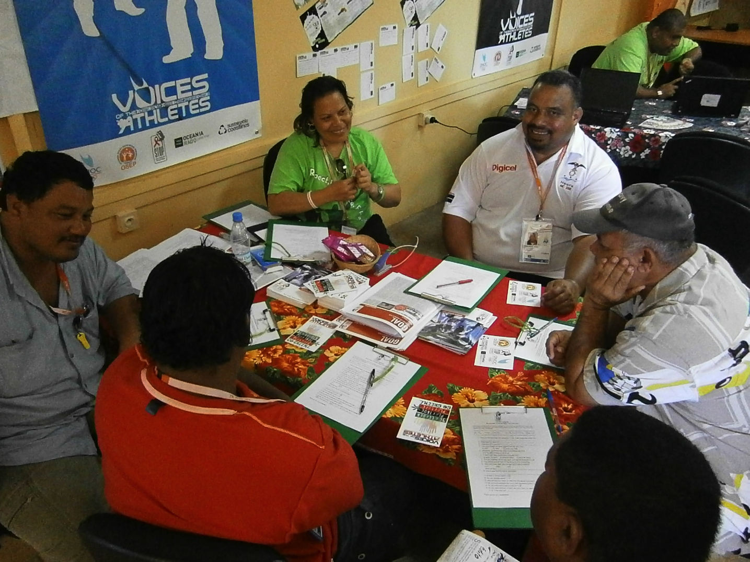
Role of ONOC
To represent Oceania in the International Olympic Committee in sporting excellence and development
17 members and 2 associate members
Manage Olympic Solidarity funds and service deliverers for sport education, HIV prevention and Anti doping

Slide 3
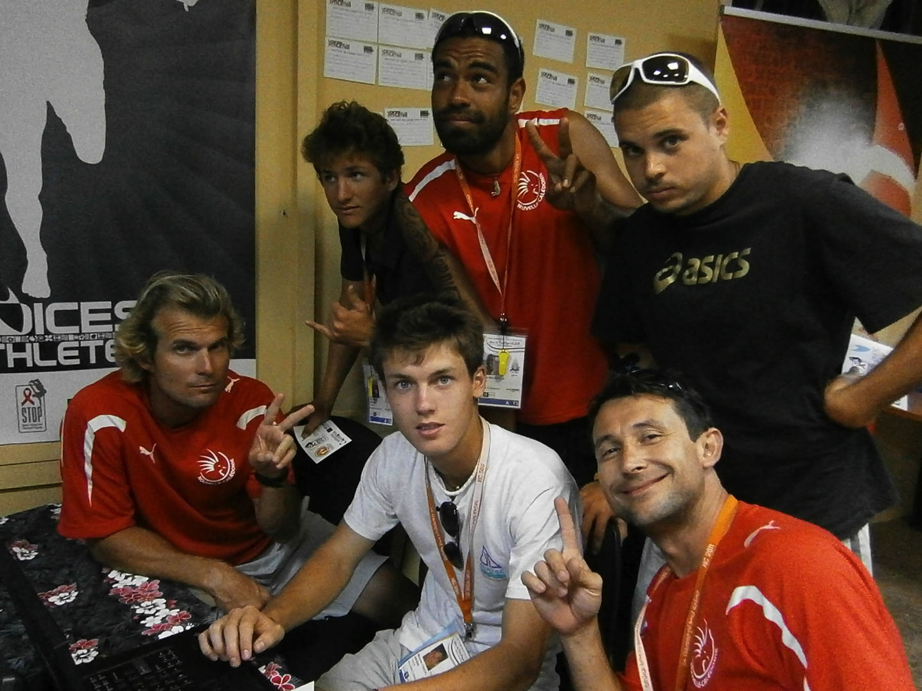
Voices of the Athletes (VOA)
The Voices of the Athletes is a joint education initiative between ONOC programs: Athletes Commission, ORADO, STOP HIV and Love your Coast at sport events
Promote 4 key messages – Be a Leader, Play True, Play Safe and Go Green to primarily educate our athletes
Vote for athletes representative on PGC Council Board

Slide 4
Progress of VOA
Total of 473 athletes
Top 5 countries - Fiji, PNG, Solomon’s, NC & American Samoa
None yet from CNMI, Marshall Islands, Niue & Norfolk
Overwhelming interest in the message
Strong desire to deliver in own countries post games
Notes:
42 amer

Slide 5
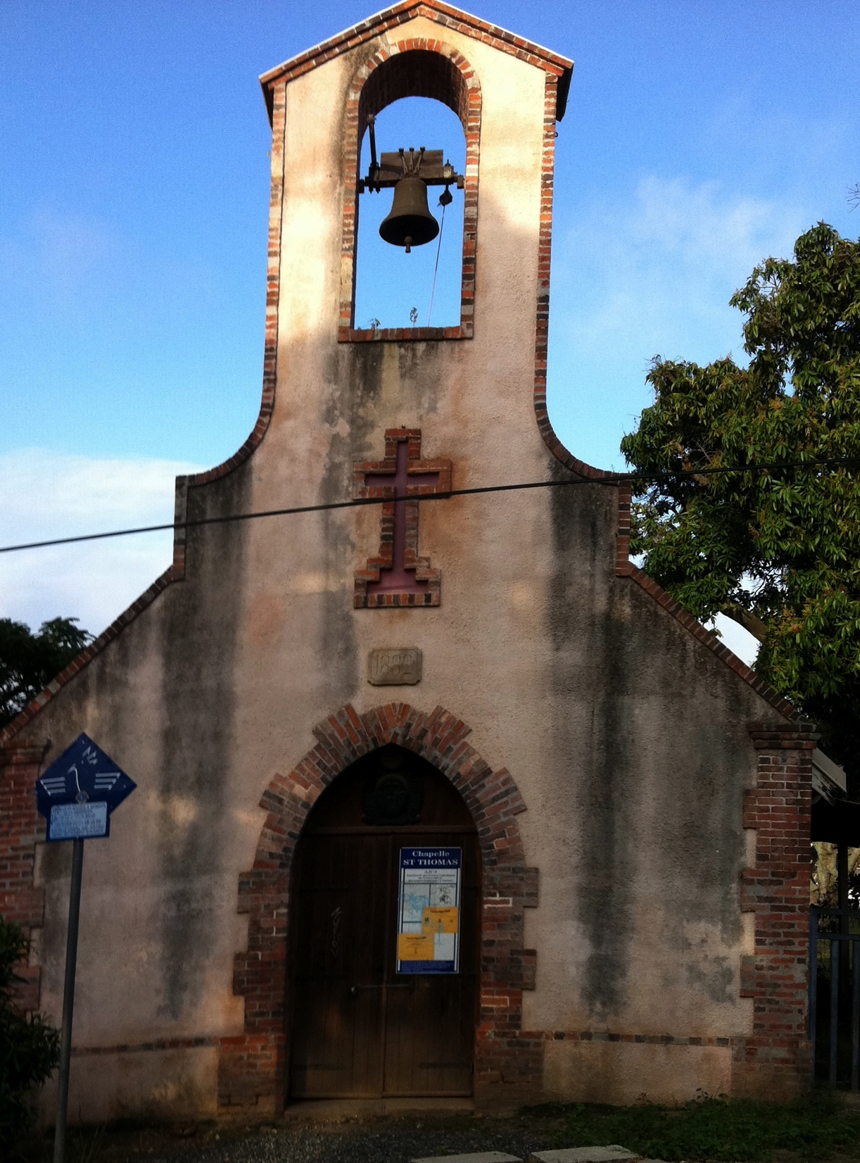
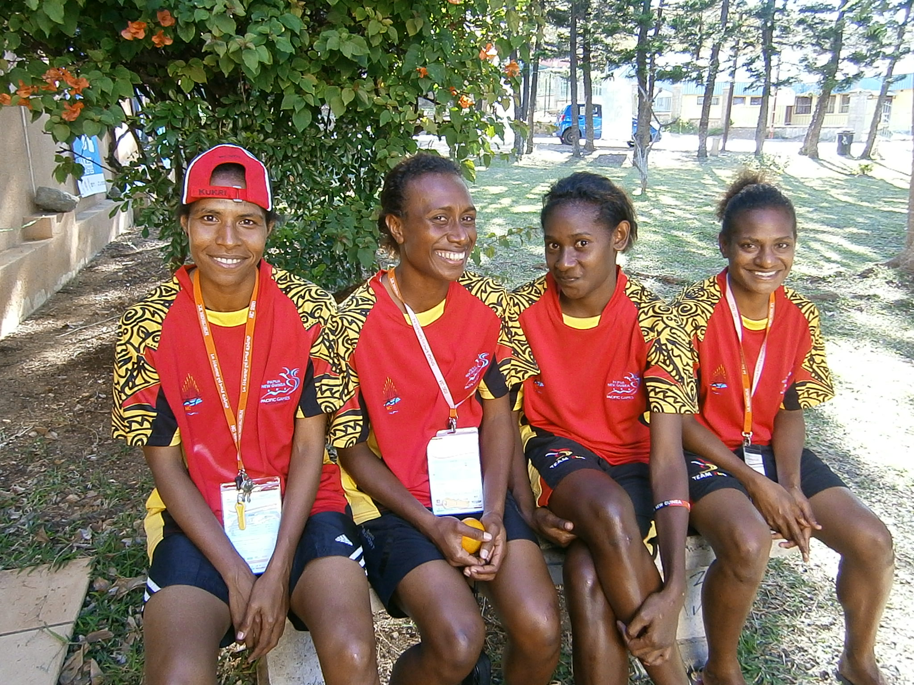
Contact
VOA outside this room
St Thomas Chapel in Games Village
www.oceaniasport.com/onoc

