Slide 1
Welcome Title
WELCOME TO THE
2010 UNDER 13
BEST AND FAIREST COUNT

Slide 2
Introduce Presenter
2010 UNDER 13
BEST AND FAIREST COUNT
Presenter
Steve Maxwell

Slide 3
Round 1
2010 UNDER 13
BEST AND FAIREST COUNT
ROUND 1
5
4
3
2
1
Luke Webb
 |  |  | V
14 | 9 | 93 |  | 5 | 2 | 32
WON BY 61 POINTS
Glenorchy
Claremont
Ben Karmaric
Nathan Rowlands
Hayden Styles
Jesse Quinn

Slide 4
Round 1
2010 UNDER 13
BEST AND FAIREST COUNT
ROUND 2
5
4
3
2
1
Brady Quinn
 |  |  | V
5 | 4 | 34 |  | 6 | 9 | 45
LOSS BY 11 POINTS
Glenorchy
Kingborough
Liam Lapham
Luke Webb
Liam Smith
Daniel Stocks

Slide 5
Round 1
2010 UNDER 13
BEST AND FAIREST COUNT
ROUND 3
5
4
3
2
1
Luke Webb
 |  |  | V
3 | 5 | 23 |  | 7 | 6 | 45
LOSS BY 25 POINTS
Glenorchy
Sandy Bay
Daniel Stocks
Liam Lapham
Brady Quinn
Nathan Percey

Slide 6
Round 1
2010 UNDER 13
BEST AND FAIREST COUNT
ROUND 4
5
4
3
2
1
Daniel Stocks
 |  |  | V
16 | 13 | 109 |  | 1 | 1 | 7
WON BY 102 POINTS
Glenorchy
Kermaine
Ben Karmaric
Nathan Percey
Jacob Lehmann
Brady Quinn

Slide 7
Round 1
2010 UNDER 13
BEST AND FAIREST COUNT
ROUND 5
5
4
3
2
1
Joel Berry
 |  |  | V
3 | 6 | 24 |  | 11 | 3 | 69
LOSS BY 45 POINTS
Glenorchy
Brighton
Joshua Smith
Nathan Rowlands
Hayden Styles
Jesse Quinn

Slide 8
Leaderboard 3
2010 UNDER 13
BEST AND FAIREST COUNT
LEADER BOARD
1
Luke Webb (13)
7
Joel Berry (5)
2
Daniel Stocks (10)
8
Hayden Styles (4)
3
Brady Quinn (8)
9
Nathan Percey (4)
4
10
LEADERBOARD
Ben Karmaric (8)
Joshua Smith (4)
5
11
Liam Smith (2)
Liam Lapham (7)
6
Nathan Rowlands (6)
12
Jesse Quinn (2)

Slide 9
Round 1
2010 UNDER 13
BEST AND FAIREST COUNT
ROUND 6
LEADER BOARD
Luke Webb
Luke Webb
Daniel Stocks
Brady Quinn
5
4
3
2
1
Joel Berry
Brady Quinn
Daniel Stocks
 |  |  | V
9 | 8 | 62 |  | 3 | 3 | 21
WON BY 41 POINTS
Glenorchy
Sorell
Luke Webb
Ben Karmaric
Nathan Rowlands
Nathan Rowlands
Liam Lapham
Nathan Percey
Nathan Percey
Nathan Rowlands
Ben Karmaric
Brady Quinn

Slide 10
Round 1
2010 UNDER 13
BEST AND FAIREST COUNT
ROUND 7
LEADER BOARD
Luke Webb
Luke Webb
Brady Quinn
Brady Quinn
5
4
3
2
1
Jacob Bevis
Daniel Stocks
Nathan Rowlands
 |  |  | V
6 | 7 | 43 |  | 5 | 4 | 34
WON BY 9 POINTS
Glenorchy
New Norfolk
Evan Langridge
Nathan Rowlands
Daniel Stocks
Nathan Rowlands
Nathan Percey
Nathan Percey
Luke Webb
Ben Karmaric
Ben Karmaric
Brady Quinn

Slide 11
Round 1
2010 UNDER 13
BEST AND FAIREST COUNT
ROUND 8
LEADER BOARD
Luke Webb
Luke Webb
Brady Quinn
Brady Quinn
5
4
3
2
1
Luke Webb
Nathan Rowlands
Daniel Stocks
 |  |  | V
12 | 8 | 80 |  | 3 | 3 | 21
WON BY 59 POINTS
Glenorchy
Sandy Bay White
Liam Smith
Daniel Stocks
Nathan Rowlands
Daniel Stocks
Nathan Percey
Nathan Percey
Sam Percy
Ben Karmaric
Ben Karmaric
Jesse Quinn

Slide 12
Round 1
2010 UNDER 13
BEST AND FAIREST COUNT
ROUND 9
LEADER BOARD
Luke Webb
Luke Webb
Brady Quinn
Brady Quinn
5
4
3
2
1
Luke Webb
Daniel Stocks
Daniel Stocks
 |  |  | V
14 | 13 | 97 |  | 4 | 1 | 25
WON BY 72 POINTS
Glenorchy
North Hobart
Nathan Percey
Nathan Rowlands
Nathan Rowlands
Evan Langridge
Nathan Percey
Nathan Percey
Liam Lapham
Ben Karmaric
Liam Lapham
Patrick Davis

Slide 13
Round 1
2010 UNDER 13
BEST AND FAIREST COUNT
ROUND 10
LEADER BOARD
Luke Webb
Luke Webb
Brady Quinn
Daniel Stocks
5
4
3
2
1
Luke Webb
Daniel Stocks
Nathan Percey
 |  |  | V
21 | 6 | 132 |  | 2 | 1 | 13
WON BY 119 POINTS
Glenorchy
Lauderdale
Hayden Styles
Nathan Rowlands
Brady Quinn
Nathan Percey
Nathan Percey
Nathan Rowlands
Daniel Stocks
Liam Lapham
Liam Lapham
Liam Lapham

Slide 14
Leaderboard 3
2010 UNDER 13
BEST AND FAIREST COUNT
LEADER BOARD
1
Luke Webb (32)
7
Hayden Styles (8)
2
Daniel Stocks (15)
8
Ben Karmaric (8)
3
Nathan Percey (15)
9
Evan Langridge (7)
4
10
LEADERBOARD
Brady Quinn (14)
Joel Berry (6)
5
Nathan Rowands (12)
11
Jacob Bevis (5)
6
Liam Lapham (10)
12
Joshua Smith (4)

Slide 15
Round 1
2010 UNDER 13
BEST AND FAIREST COUNT
ROUND 11
5
4
3
2
1
Nathan Rowlands
 |  |  | V
3 | 8 | 26 |  | 7 | 13 | 55
LOSS BY 29 POINTS
Glenorchy
Cygnet
Nathan Percey
Daniel Stocks
Luke Webb
Jesse Quinn

Slide 16
Round 1
2010 UNDER 13
BEST AND FAIREST COUNT
ROUND 12
5
4
3
2
1
Nathan Percey
 |  |  | V
3 | 3 | 21 |  | 18 | 10 | 118
LOSS BY 34 POINTS
Glenorchy
Clarence Roos
Michael Harris
Joel Berry
Liam Smith
Daniel Stocks

Slide 17
Round 1
2010 UNDER 13
BEST AND FAIREST COUNT
ROUND 13
5
4
3
2
1
Daniel Stocks
 |  |  | V
10 | 13 | 73 |  | 6 | 3 | 39
WON BY 34 POINTS
Glenorchy
Triabunna
Nathan Rowlands
Brady Quinn
Timothy Underwood
Luke Webb

Slide 18
Round 1
2010 UNDER 13
BEST AND FAIREST COUNT
ROUND 14
5
4
3
2
1
Brady Quinn
 |  |  | V
11 | 3 | 69 |  | 2 | 2 | 14
WON BY 55 POINTS
Glenorchy
Clarence
Luke Webb
Liam Smith
Daniel Stocks
Joel Berry

Slide 19
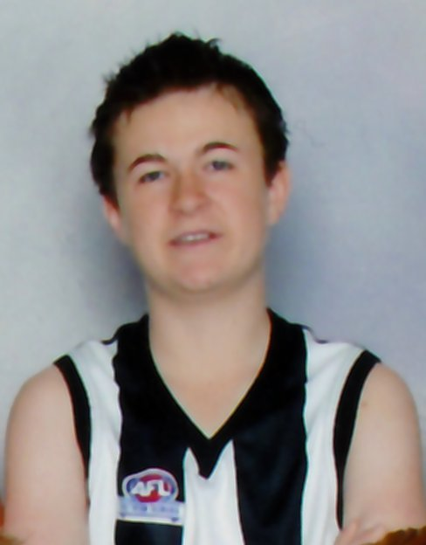
Runnerup
2010 UNDER 13
BEST AND FAIREST COUNT
Under 13 BEST & FAIRST RUNNER UP
Nathan Percey

Slide 20
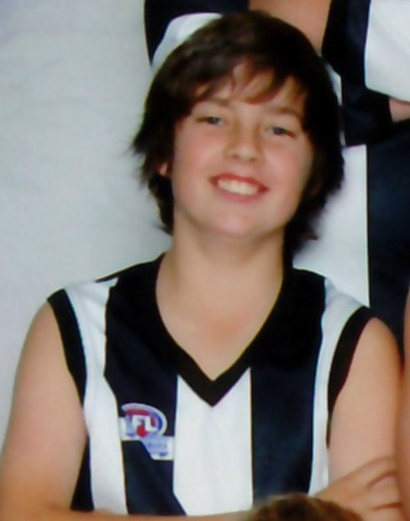
Winner
2010 UNDER 13
BEST AND FAIREST COUNT
Under 13 BEST & FAIRST WINNER
Luke Webb

Slide 21
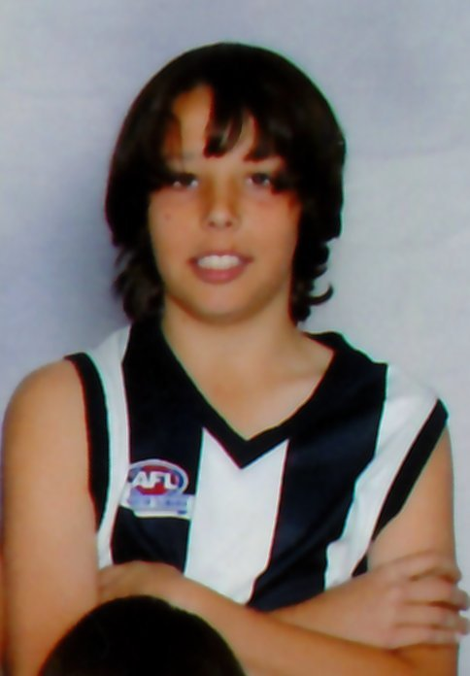
Coach Award
2010 UNDER 13
BEST AND FAIREST COUNT
MOST CONSISTENT
Daniel Stocks

Slide 22
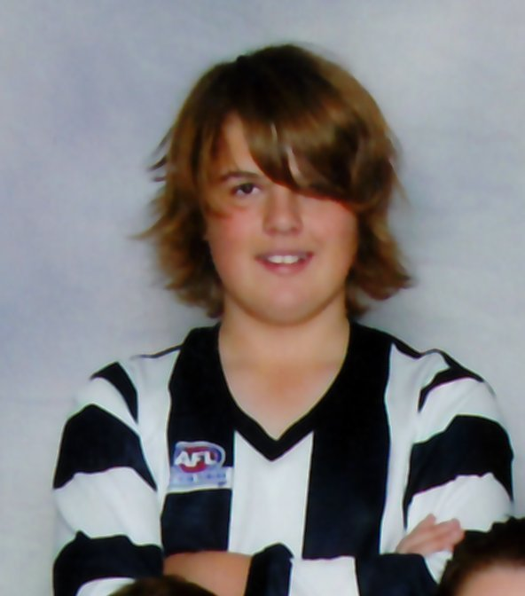
Coach Award
2010 UNDER 13
BEST AND FAIREST COUNT
MOST IMPROVED
Joel Berry

Slide 23
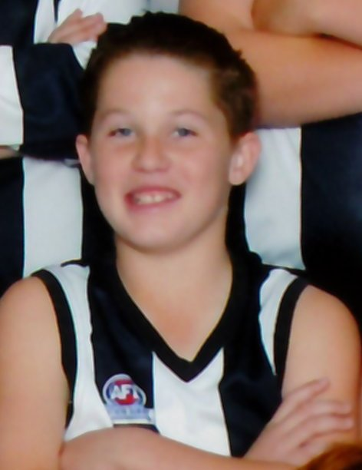
Coach Award
2010 UNDER 13
BEST AND FAIREST COUNT
COACHES AWARD
Liam Smith

Slide 24
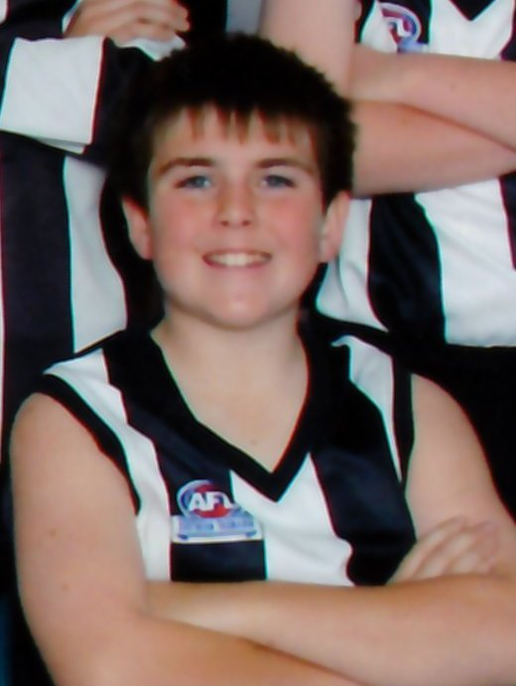
Coach Award
2010 Under 13
BEST AND FAIREST COUNT
BASS & EQUITABLE AWARD
Michael Harris

Slide 25
Congratulations (all winners)
2010 UNDER 13
BEST AND FAIREST COUNT
CONGRATULATIONS TO THIS YEAR’S WINNERS:
Michael Harris
Liam Smith
Joel Berry
Daniel Stocks
Nathan Percey
Luke Webb

Slide 26
Leaderboard 3
2010 UNDER 13
BEST AND FAIREST COUNT
LEADER BOARD
1
Luke Webb (39)
7
Joel Berry (10)
2
Daniel Stocks (26)
8
Liam Lapham (10)
3
Nathan Percey (24)
9
Hayden Styles (8)
4
10
LEADERBOARD
Brady Quinn (22)
Ben Karmaric (8)
5
11
Evan Langridge (7)
Nathan Rowlands (21)
6
Liam Smith (11)
12
Jacob Bevis (5)

