Slide 1
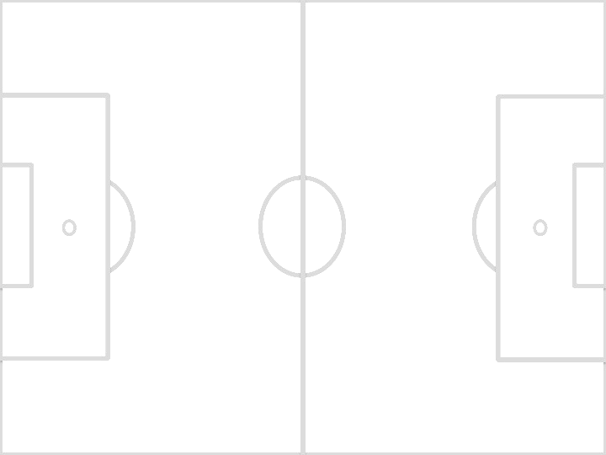
Waramanga Playing Fields Small sided Fields for U8 and U9s (7 Players v 7 Players) for 2017 Season
Used by all U8 and U9 teams.
Fields for 2017 will use the space between the Penalty box and half way of each of the Full Fields 101, 102, 103 and 104 and may include one dedicated field as shown on the U8/9 Field map.
These Fields take advantage of existing markings to define the Touchlines.
There will only be space between fields at for Home and Away Teams, their Coaches and Managers
All fields will use the Under 10/11 touchline (typically Black) and the Penalty Box (white) for the touchlines.
If there is no match scheduled on the adjacent field then teams and spectators may use the space between fields.
Fields are: J1A, J1B, J2A, J2B, J3A, J3B, J4A, J4B and J5
Notes to help set up:
Use the PVC plumbing pipe Goals. No nets.
The Goal Line aligns with the edge of the Penalty Box.
Define the whole Goal Line with your cones except between the goal posts
Place the Goals so they are equal distance from the corners on the Goal Line
Place the Flags on each corner.
Each Team has the responsibility to clear the field of one Goal and their cones if there is no need to leave the field for following U8/9 Games.
1.5m
Goal Line
Goal
30-33m
No Spectators, Team access only
Halfway Full Field
Full Field Penalty Box
40.3m
Goal Line
Goal
Each Team should set up one goal, two flags and use their team cones to Define one Goal Line.

