Slide 1
AFL (NSW/ACT) Community Umpiring Update 2016
https://www.youtube.com/v/cIFqvZ0T3FI?version=3&f=playlists&app=youtube_gdata

Slide 2
Agenda
AFL (NSW/ACT)
NSW/ACT Community Umpiring Structure
AFL’s National Umpiring Strategy
Umpiring Pathway in NSW/ACT
What’s new in Community Umpiring
Club & League responsibilities
Club Appointed Umpires

Slide 3
NSW/ACT Community Umpiring Structure
Community Umpiring Manager NSW/ACT
Graham Glassford
- AFL Sydney
- AFL North Coast
Umpiring Development Coordinator (ACT/South Coast)
Cameron Black
- AFL Canberra
- AFL South Coast
- Sapphire Coast AFL
Umpiring Development Coordinator (SNSW)
Troy Mavroudis
- AFL Riverina (Farrer & Riverina FL)
- Hume FL & Northern Riverina FL
- AFL Broken Hill
Umpiring Development Coordinator (NNSW)
Carl Fletcher
- Greater Sydney Juniors
- Black Diamond AFL
- AFL Central West
- Tamworth AFL

Slide 4
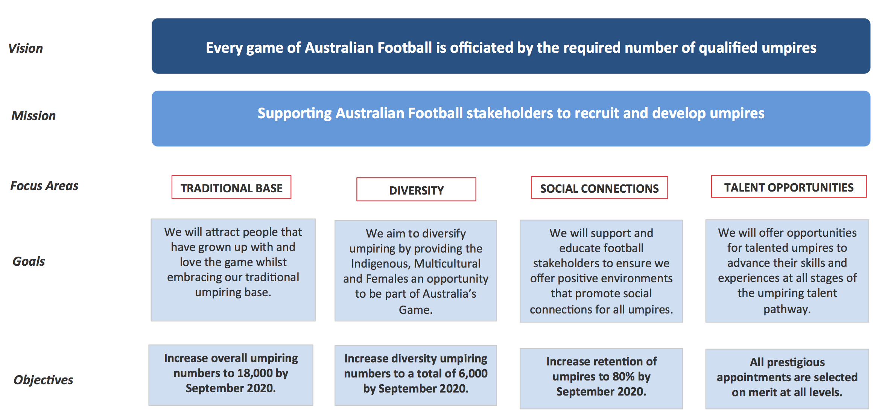
AFL’s National Umpiring Strategy

Slide 5
Umpiring Strategy – Major Local Objectives
Increase umpire numbers by
Retention
Enhanced engagement
Improved coaching & communication
Engagement Bonus to encourage training attendance
Recruitment
Locally developed recruitment initiatives
Ambassador programs at Junior Clubs
Promotion
Clear career pathways
Increase quality by;
Umpire education & Accreditation
Umpire Coach education & Accreditation

Slide 6
Umpiring Talent Pathway NSW/ACT
AFL National Panel
AFL Rookie Panel (field umpires only)
NEAFL State League Panel
NEAFL Development Squad
Senior Community Football
Emerging Umps Squad
Next Gen Squad (field umpires only)
Junior Football

Slide 7
What’s new in community umpiring
Uniform standardization -> green
Green shirt program ceased
New “Trainee Umpire” identification program
Umpire & Umpire Coach Accreditation process streamlined and simplified

Slide 8
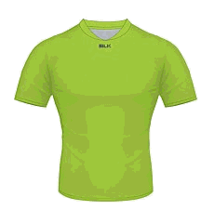
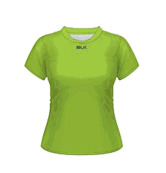
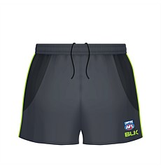
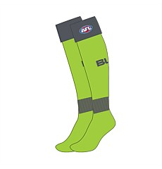
Uniform & Trainee Umpire Updates

Slide 9
Club Appointed Umpires
Must be registered and certified
WHY?
Minimum level competency
Understand basic skills, role and responsibilities
Better outcomes for game/league
More enjoyable match by all participants

Slide 10
Club Appointed Umpires - Process
Must register on Sporting Pulse (footyweb)
Choose appropriate league/group
Club umpire accreditation course
http://www.learningseat.com/servlet/ShopFrontPage?companyId=AFLCOMMUNITYCLUB
Go to umpiring tab
30 min online course prior to first match
Print out certificate of completion
Assessed by an suitable assessor during one match
Completed assessor course (online & phone review)
Accredited umpire, accredited umpire coach or accredited opposition coach
Signed off and returned to AFL (NSW/ACT)

Slide 11
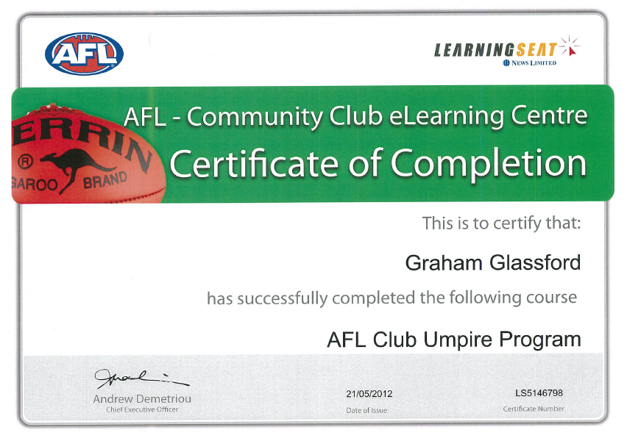
Club Appointed Umpire Certification

Slide 12
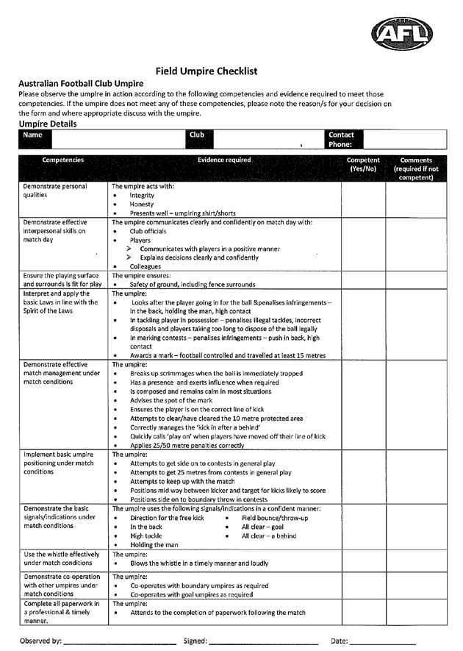

Slide 13
Club Appointed Umpires
Match day duties
Officiate the match, impartially, to the best of their ability
Complete all relevant paperwork at the conclusion of the match
Best & fairest voting
Code of conduct or similar
Any reports if applicable
Job not over when the siren goes but 10-15 minutes post match

Slide 14
Club Appointed Umpires
If not registered/certified
Not registered
not covered by insurance
Not certified
Have not completed basic training/knowledge
Diminished match outcomes
We need your support
Sanctions/penalties for clubs providing non-certified club appointed umpires
Fines/loss of Code of Conduct or similar points
Include in match paperwork (certification number)

Slide 15
League Appointed Umpires - Process
Register online via Sportingpulse (footyweb)
Must compulsory undergo Introductory (Level 1) Accreditation in first year
Must complete 1.5 hour online course prior to officiating in their first match
Assessed under match conditions as competent in ALL required areas by an approved assessor
Accredited umpire coach/L2 accredited umpire
Re-assessed at a later date if not competent in specific areas

Slide 16
What is most important for good umpiring
Umpiring groups (league appointed umpires)
Proper structure with adequate funding
Shared load; when one key person leaves it all falls over
Environment
Club appointed umpires
Registered and accredited (trained!) to a minimum competency
League sanctions if not followed
Recommend inclusion in match paperwork (certification number)

