Slide 1
USA College Basketball

Slide 2
Why the USA?
Basketball is a major sport in the USA
Profile
Talent
Cost Saving - If you are good enough, very expensive if you are not recruited
Meeting new and different people
Level of Basketball (Div I, Div II and Div III)
Pathway

Slide 3
Coaches
How do I get to be seen?
What do I need to do?
Who can help?
What do they look for?
USA Coaches – they are paid, they have a JD, results matter

Slide 4
Physical Attributes
Speed
Size
Skill Level
Shooting
Mental Attributes/toughness
..... The list goes on

Slide 5
Year Levels
Freshman
Sophomore
Junior
Senior

Slide 6
What’s Provided
Weights
Training Facilities
Doctors
TV coverage
Games
An Education (watch this one! It depends on what is in the scholarship)
An offer and your signature

Slide 7
Rules
Red Shirt
Gap Year
Transfers – eligibility (if you spend time at an NZ University then go over to the USA you loose your eligibility for each year in a NZ university equals one year less at a USA College)
Watch the rules if you enter a contract to play professionally you must check out eligibility

Slide 8
How do I qualify?

Slide 9
Educational Requirements
Two main points
SAT (complete asap, you can have a second attempt)
University Entrance
The onus of proof is on the player. You must prove that you have met the requirements.

Slide 10
Reports and Certified Copies of Results
Have them available
Talk to someone at your school. There is a high probability that this person will be contacted.
A file needs to be maintained that once interest is indicated that has
Certified results
GPA
Reports
References

Slide 11
University Entrance
You should ensure that you have met the requirements for New Zealand University Entrance
The subjects you take matters
USA requirements: An English course, a Mathematics course, a Science course, a Social Science course, you need 5 subjects so another course from English, Maths, Science or a Social Science can be selected. In this area look at domains of learning.
A Language?
Physical Education? (this is where you play games in the USA)

Slide 12
The Requirements
There is room for movement here. BUT I strongly recommend that you look you SELECT with care
Marks/subjects do matter and the onus of proof lies with you.

Slide 13
The Rules

Slide 14
Graduation Date
This is one to watch. It is possible to “Graduate” before you sit the external exams.
It is difficult to explain the difference between University Entrance and Level 3 NCEA (for the NCAA)

Slide 15
Grade Point Average
Quality matters
I suggest you look at the Auckland University Website and the grade point calculator. Use it set goals (where do I need to be?)

Slide 16
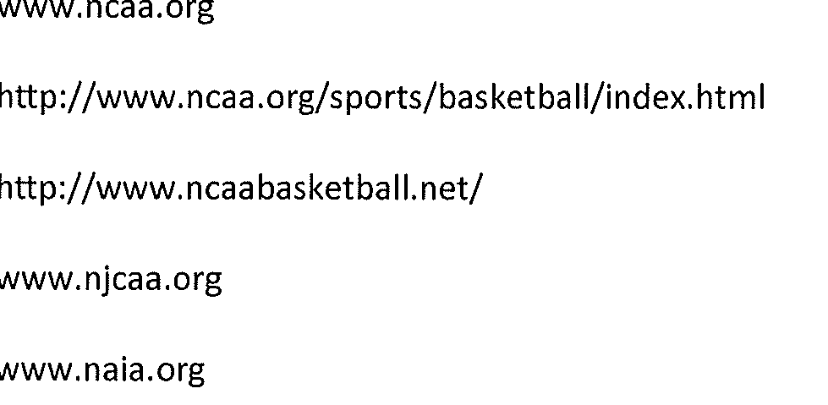
Websites to check out

