Slide 1
AFL Level 1 Coach Physical Preparation Steve Forcone

Slide 2
Presenter Information
Calder Cannons & HPM as S&C coach
Level 1 AFL Coach presenter
‘Training Sense’ - Sport & Fitness qualifications
Masters of S&C through Edith Cowan University (WA)
Personal background in Weightlifting

Slide 3
Topics
Injury Prevention
Performance Improvement

Slide 4
Sub-Topics
Physical preparation
Fitness
Younger athletes
Movement/Injury
(& key anatomy)
Training methods

Slide 5
Section 1: Movement Factors Injuries

Slide 6
Relevance of Movement
Preparation should align common movement patterns & types
AFL = multi-directional, multi-faceted

Slide 7
2010 GPS Report
Statistically significant increases in two key components:
Accelerations over 10km/h in 1sec
Decelerations over 10km/h in 1sec
Relatable to all levels of competition?
Require more data across levels

Slide 8
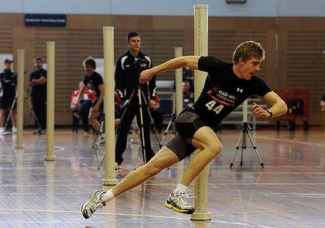
Relevance of Movement
AFL involves ‘explosive’ actions both stopping and starting
Repeated in large volumes
Considerably augmented force on body structures
Significant aerobic condition required

Slide 9
Injury
Determining issue in participation
Injured players cannot play (obviously)

Slide 10
2010 Injury Report
Major injury prevalence:
Hamstring strain
Groin strain/OP
Ankle joint sprains
Calf strain, quadriceps strain, lumbar/thoracic injury, knee cartilage injury
Shoulder sprain & dislocation

Slide 11
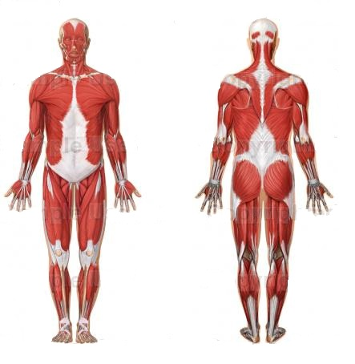
Preparation Focus – Injury prevention
Shoulder
Trunk
Groin
Hamstring
Quad
Calf/ankle

Slide 12
Section 2: Key Fitness Components

Slide 13
Fitness Components
Based on performance & injury data key components of Physical Preparation for AFL:
Muscular strength
Aerobic endurance/power
Speed & Change of Direction (inc. Power)
RUNNING ABILITY = main focus

Slide 14
Running Ability
Repeated sprint performance not only determined by how ‘fit’ an athlete is
Repeated sprinting
Neuromuscular aspect:
Strength
Speed
Power
Metabolic aspect:
Recovery b/w efforts
Clearance of wastes
Aerobic fitness
Buccheit (2008)

Slide 15
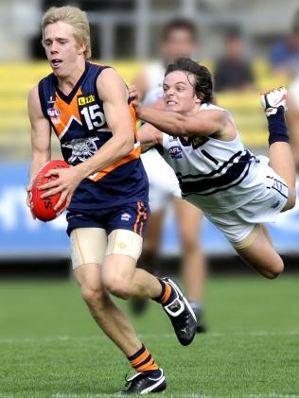
Muscular Strength
Strength underlies most (if not all) performance and IP characteristics
Required for effective handling of forces (IP)
Both application and absorption
E.g. Consider ability to stop dead at top speed (change of direction) then take off again (acceleration, speed)
Eccentric strength crucial

Slide 16
Muscular Strength
Leg strength repeatedly correlated to improved sprinting & CoD performance in:
Soccer, Rugby League, Basketball, Softball, 100m
Similar work required in AFL
Data is largely transferrable
How does strength impact on performance?
Requena et al. (2009), Baker & Nance (1999), Chaouachi et al. (2009), Nimphius et al. (2010), Bret et al. (2002), Lockie et al. (2011)

Slide 17
Muscular Strength
Speed & CoD = Power = force*(distance/time) i.e. Velocity
Power
Heavy resistance training
Explosive resistance training
Power = FORCE * velocity
Power = force * velocity
Mixed methods
Newton & Kraemer (1994)

Slide 18
Aerobic Fitness
During repeated maximal work aerobic metabolism essential for recovery
AFL players:
12.5-13.5km covered on average
>160-220 efforts over 18km/h per match
Aerobic endurance essential, but at high speeds

Slide 19
Aerobic Fitness
AFL data does not show distinct link between distance covered and winning
Other sports show some link (i.e. EPL)
Greater aerobic endurance from testing =
Increased distance covered
Increased #of sprints
Assume that elite fitness contributes to elite performance

Slide 20
Section 3: Training & Preparation

Slide 21
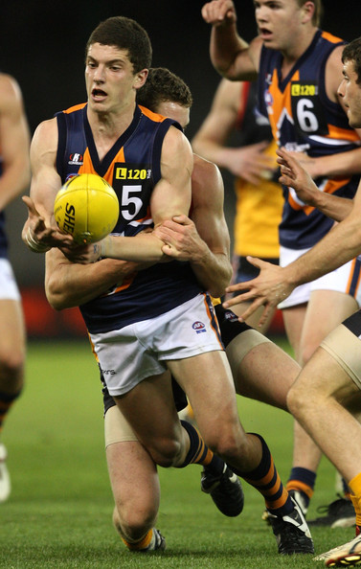
Preparation Focus – Strength
Athletes at all levels must be strong first
Strength = faster, more powerful, less susceptible to injury
Important to mix methods (i.e. Heavy vs. Fast)
Something is better than nothing (i.e. Cannons bodyweight programs)
More important for young athletes

Slide 22
Preparation Focus – Strength
Progression of strength based around ability
Basic progression (yrs):
Bodyweight exercises
Resistance
Heavy resistance + Power
ASCA (2008), Balyi & Hamilton (2008)

Slide 23
Preparation Focus – Strength
Progression takes time
Should only occur with excellent technique
Basic exercises effective (squat, pull up, balance, jumps etc.)
Recall key body areas
Recall key movements (weightlifting progressions mimic movements closely)
Implement competition – e.g. Pull ups - safely

Slide 24
Preparation Focus – Aerobic Fitness
Progression takes time
Time efficient training important (i.e. Football training is for football)
Mixed methods: specific (Small games) vs. General (interval running etc.)
Modern methods: MAS & intervals – Dan Baker article

Slide 25
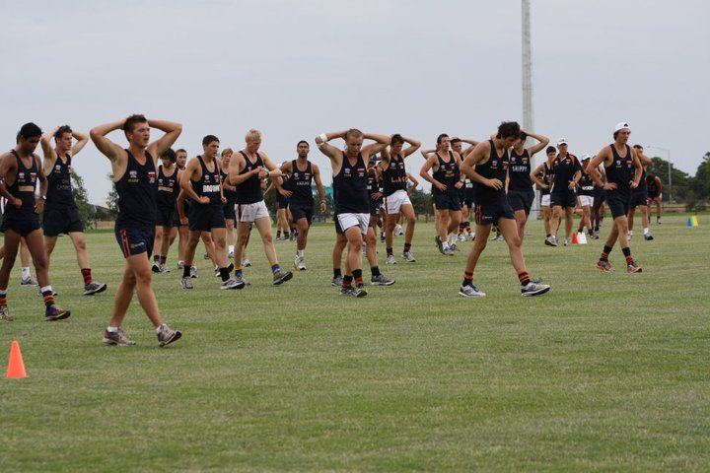
Preparation Focus – Aerobic Fitness
MAS = Maximal Aerobic Speed
Highly effective as highly individual
Obtained from field tests
At local level may assume MAS from time trial (not as accurate)

Slide 26
Preparation Focus – Aerobic Fitness
MAS & similar training yields excellent results
Significant improvements in VO2 max shown in elite and sub-elite athletes
Useful as training load controllable & velocity high
120% MAS, with 15s/15s for 2*8mins shown to induce greatest effect
Buccheit (2008), Dupont (2004), Billat (2001)

Slide 27
Preparation Focus – Aerobic Fitness
MAS not only method
More traditional methods also effective in team sport athletes e.g.
4*4mins @ 100%, 3-4mins passive rest b/w
Mixed approach useful
Considerations to distance covered and load
Helegreud et al. (2001), Helegreud & Hoff (2004)

Slide 28
Preparation Focus – Aerobic Fitness
Specific training can also improve VO2 max
Small-sided games (SSG’s) give match practice (decision making) + fitness benefit
Dependant on: game size, game rules, #of players, presence of floating player
Possible to under-train highly fit individuals
Hill-Haas (2011), Gabbett (2009)

Slide 29
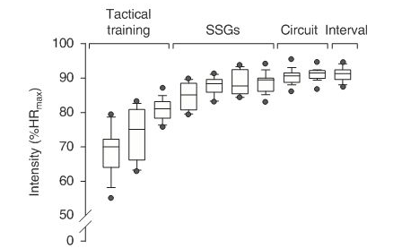
Preparation Focus – Aerobic Fitness

Slide 30
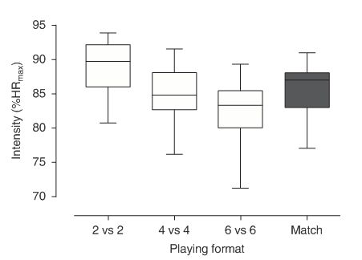
Preparation Focus – Aerobic Fitness
Hill-Haas (2011)

Slide 31
Preparation Focus – Aerobic Fitness
Again mixed approach useful
Consider load: small area = multiple CoD’s, tackles > increased load
Timing and organisation of drills important
Hill-Haas (2011), Gabbett (2006)

Slide 32
Preparation Summary
AFL physical performance dependant on running ability
Strength is major component of speed, CoD, injury prevention
Aerobic fitness important in recovery between efforts

Slide 33
Section 4: Young Athletes

Slide 34
Young Athletes
Greater emphasis placed on development (TAC Cup, State Academies etc.)
Younger bodies = less physically able
Athletes like a new house, require solid foundation (2years+)
Interesting junior training stories

Slide 35
Young Athletes
Typically in AFL, 1st year player loads:
Approx. 50% to 70% of senior player
Skills - 80/90%
Running - 60/80%
Weights - 30/40% (increase?)
Similar format should be followed across levels of competition
Nick Ames (2010), ‘AFL Physical Development’

Slide 36
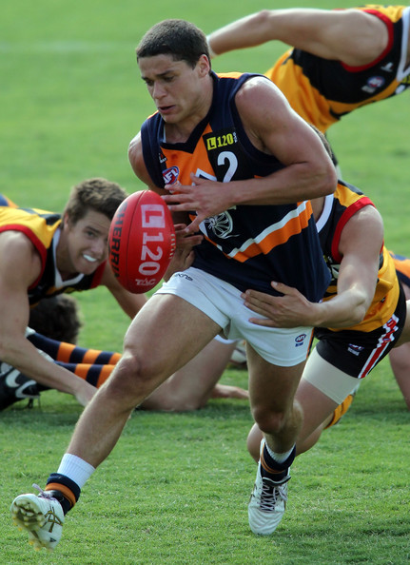
Young Athletes
Calder Cannons TAC Cup
17yo’s typically lower loads (running)
Limited time and resources – must choose simple methods to control load (i.e. Distance covered, RPE)

Slide 37
Young Athletes Summary
Major focus with younger athletes = sound strength and coordinated movement
Aerobic conditioning with speed focus (monitoring the load)
Basic training is reality e.g. Cannons programs
Good strength, ability to move, and condition leads to better platform as a 21-25 y.o

Slide 38
Section 5: Other Factors

Slide 39
Other factors
Warm up
Dynamic > constantly moving
Static stretching likely negative (McHugh & Cosgrave 2009) – psych benefit?
Progressive intensity
‘Peak before performance’
Cannons: Match day 12-15minutes > rest/piss/drink > 5minutes high intensity

Slide 40
Other factors
Recovery methods:
Cool down (EPL players, Reilly & Rigby 2009)
Cryotherapy (ice, cold shower, reduce temp)
Water immersion (cold, hot?)
Hydrostatic pressure improves DOMS & cardiac output/blood flow
Delivery of nutrients etc.
Sleep
NS shutdown – tissue repair

Slide 41
Other factors
Nutrition:
Protein supplementation (Pre/post = effective, Cribb & Hayes 2006)
High CHO diet – moderate fat intake – fat athletes = reduced CoD (Sheppard et al. 2009, Gabbett et al. 2008, Sheppard & Young 2006, Chaouachi et al. 2009)
Hydration
Slurpees?

Slide 42
Physical Preparation
AFL multi-faceted sport
Physical preparation should focus on:
Common movements
Key muscles used
Relevant fitness components – strength (speed, CoD), aerobic fitness
Mixed approach to preparation
Young athletes require slightly different/reduced training focus
Other factors – recovery, nutrition, warm up

Slide 43
Thank you Questions: steveforcone@gmail.com

